Slide 1
Sales Playbook
Dell Displays & Client Peripherals Product Details
Internal Use - Confidential

Slide 2

Document usage
This document is intended for sales makers and provides an overview of Displays & Client Peripherals solutions.
This is an internal document. Please refer to customer presentation for customer-facing materials and content.
Slides flagged with this icon - - information requires a Non-Disclosure Agreement to share.
Helpful hits:
Put in presentation mode to use links.
Navigation: Table of contents has links and there is a link back to the table of contents on each slide.
Some slides have more information in the notes section.
Use slide sorter view to easily see all pages.
In normal view, you can right click the section titles (to the left of slides) to collapse or expand sections to easily move from one to another.
Competitive content

Slide 3
Updates
NEW! Put into new template.
Added new monitors, large conference room displays, projectors, and client peripherals.
Added Why CP, CP Portfolio, Docking content, including Why switch to Dell USB-C Docks and Docking portfolio overview
Added Why Dell Docks, Why Dell Keyboards, Mice, Styluses, Why Dell Power, Why Dell Audio and Why Dell Carrying Cases

Slide 4
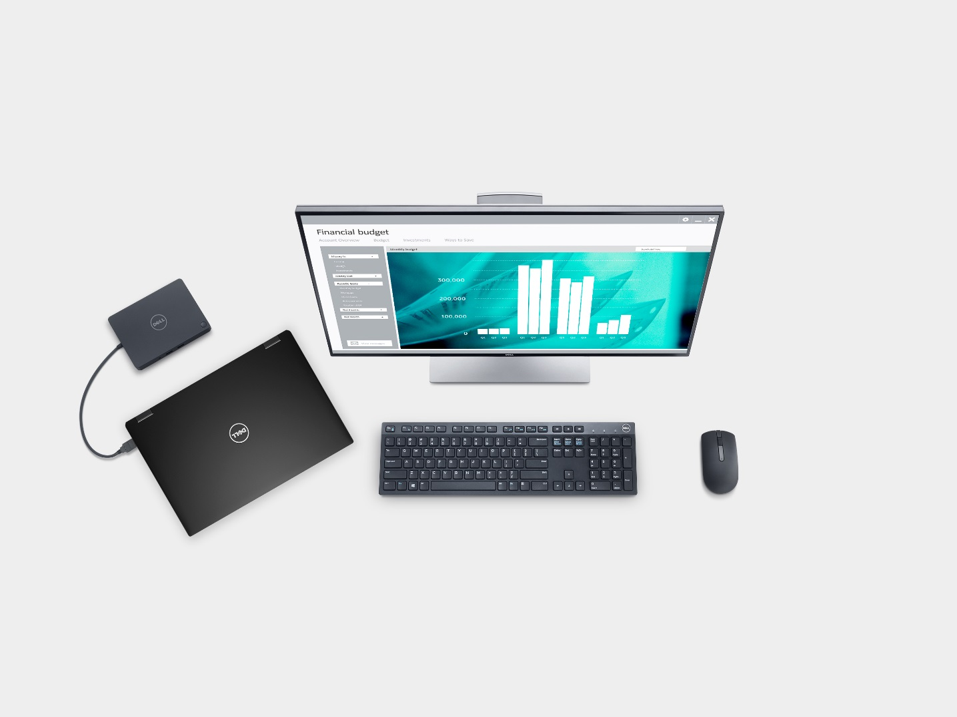
Table of contents
Why Dell for Displays & Client Peripherals
Dell Monitors
  Why Dell Monitors
  Dell UltraSharp Monitors
  Dell Monitors — P Models and E Models
  Monitor arms & stands
Dell Projectors & Conference Room Displays
  Conference Room Displays
  Dell Professional Projectors
  Dell Advanced Projectors
  Dell Mobile Projectors
  Dell Interactive Projectors
Dell Client Peripherals
  Docking solutions
  Keyboards, mice and styluses
  Audio products
  Power solutions
  Carrying cases
Resources

Slide 5
Back to Table of Contents
Why Dell for Displays & Client Peripherals
Selling the full client solution
Meet the key work personas
What so they need to be productive?
Solutions for the way people work
D&CP brand positioning

Slide 6









Selling the full client solution
Back to Table of Contents
Ecosystems are made up of the accessories that surround a system – from monitors and keyboards, to mice and carrying cases, to projectors, printers and more.
Dell-branded accessories are designed for and tested with Dell systems to enable productivity for targeted end-users.
Each system has an ecosystem of accessories chosen or designed specifically for that system.
Ecosystems designed for however your customer works - fixed, mobile, or collaborative.
Monitors
Printers
General S&P Resources: Displays and Client Peripherals Upsell Guide Mobility Recommended Accessories Reference Guide and Roadmap
Projectors
Client Peripherals
Input devices
Large Conference Room Displays
Client Peripherals
Other

Slide 7
Meet the key employee work personas
Back to Table of Contents
We know our customers and users work in a variety of ways:
Desk Centric | Corridor Warrior | Remote | On-the-Go
Today
45%
Future
39%
Today
19%
Future
20%
Today
12%
Future
14%
Today
14%
Future
12%
Someone who is working at their own desk in the office more than 50% of time | Someone who is working away from their own desk, more than 50% of the time, going from meeting to meeting and/or working from multiple locations, but within the company building(s)/campus | Someone who is working full-time (at least 30 hrs/week) outside of the company building(s)/ campus, e.g. from home or another location | Someone who works more than 50% of the time away from the office, traveling and going to off-site meetings
Admin staff/exec support Accounting/Finance Helpdesk/Customer Support Engineers Designers Sales representatives Marketing staff Other professionals (gov’t, education administrators, etc.) Programmers R&D | Managers to high-level executives in all depts. Marketers Other professionals (program managers, etc.) IT staff Professors Specialist roles Shop floor foreman Warehouse manager Nurse | Data/Claims processing Event workers Sales professionals Consultants | High/mid-level executives Marketing/Sales executives Field Engineers Services professionals (consultant, insurance adjustor, health care services, etc.)
Description
Typical Roles
Source: Ecosystem System Research, summer/fall 2014, Dell and Greenburg
Back to Table of Contents

Slide 8
What do they need to be productive?
Back to Table of Contents
Since we know where/how they work, we are able to determine what their needs are and what products can help them Do More:
Desk Centric | Corridor Warrior | Remote | On-the-Go
Today
45%
Future
39%
Today
19%
Future
20%
Today
12%
Future
14%
Today
14%
Future
12%
Need efficient use of space Stationary for long periods requires comfortable setup Single screen hinders productivity Need better ergonomics | Seamlessly transition from desk to meetings Present and share info in meetings. Stay connected on the go. Be more mobile with lightweight, portable devices | Charge up anywhere and anytime. Connect and work when moving about. Connect to core office via telephone or video conference | Connectivity / communication with office Connectivity on the go Access to important info Power on the go
Docking station Dual-displays Full-featured keyboard and mouse Adjustable Monitor Stand Headset | Additional Power Supply (External Power Companion) Active Pen Display adapter dongle Sleeve/bag Wireless monitors | Docking Station Single display Full-featured keyboard and mouse Headset External hard drive | Additional Power Supply (External Power Companion) Active Pen Display adapter dongle Briefcase/Backpack Wireless Mouse External hard drive
Key needs
Key accessories
Source: Ecosystem System Research, summer/fall 2014, Dell and Greenburg
Back to Table of Contents

Slide 9
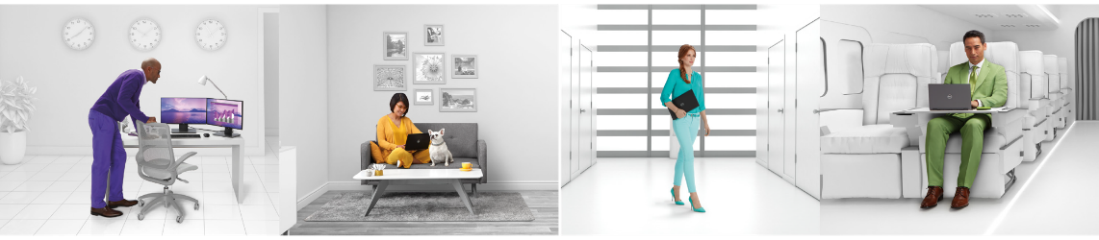




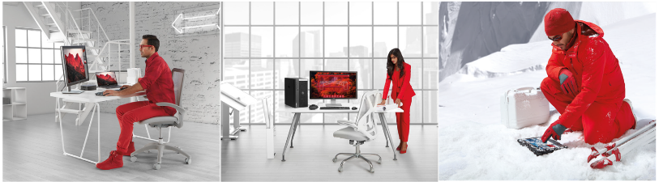

Solutions for the way people work
Back to Table of Contents
Watch for these icons for product recommendations by persona throughout this document.
Desk-centric worker
Remote worker
Corridor warrior
On-the-go pro
Through Dell research, 7 unique workstyles are defined and solutions built to each persona’s productivity needs.
Better together: Dell offers the optimal suite of compute devices, plus accessories, services and software tailored for each end user workstyle.
Our solutions deliver the right product at the right time, whichever hat your customer is wearing at any given time.
Creative
Engineer
Field Worker
Notes:
These are our commercial personas
Key points:
Literally billions of conversations and multiple research executions lead us to this – our personas that our customers most often experience in their environments
There are 4 personas and 3 more intensive users
Desk –centric employee – spends most of his time at a desk, on company premise. These are call centers, medical researchers, scientists,
Remote worker – spends most of her time off-premise but in one place off premise
Corridor warrior – spends most of her time running from meeting to meeting, collaborating in conference rooms and hallways
On the go Pro – spends most of his time off premise and on the move
As for the intensive users below, we have
Creative folks
Engineers
Both of these need powerful systems
Field worker – has a more demanding environment (factory, iceberg)

Slide 10
D&CP Brand Positioning
Back to Table of Contents
Monitors | Projectors | Client Peripherals | Printers
Award-winning Dell monitors fit your needs and budget, offering productive ways to work, proven reliability, and the industry’s most advanced monitor technologies. Dell Monitors: Reliable and environmentally efficient monitors with productivity boosting features built for everyday work and play. Dell UltraSharp Monitors: A revolutionary viewing experience with uncompromising performance and innovative design. Dell specialty monitors: Large format monitors for classrooms and conference rooms, monitors developed for healthcare, and financial trading professionals. | Dell projectors and conference room displays offer excellent image quality, collaboration features and advanced laptop and mobile connectivity options with a low total cost of ownership and simple installation. Dell Projectors: Affordable projectors with essential features Dell Network Projectors: Built for managed environments, with excellent resolution, brightness, and color Dell Mobile Projectors: Small size and light weight for those the on-the-go Interactive Projectors: Help engage students and collaborate with audiences. Dell Conference Room Displays: Enable collaboration in small and mid-size meeting rooms | Maximize the performance of your Dell system with accessories designed and tested to work with your Dell computers, notebooks, and tablets. Designed for your computing needs, allowing you to get the most out of your time and technology for work or play. | Award winning, easy-to-use Dell printers and imaging solutions improve collaboration across devices by delivering affordable and manageable solutions that enable you to easily connect, manage and own. Dell Printers and MFPS: Affordable printers designed for everyday office use, from easy installation to general printing to simple printer upkeep. Dell Cloud MFPs: Unlock the benefits of cloud connectivity with built-in Dell Document Hub for easy and more effective collaboration. Dell Smart Printers & MFPs: Reliable performance with fast speeds, efficient workflow solutions, security features, and a low total cost of ownership.
Vertical Focus
Consumers/small businesses Media & entertainment Enterprise businesses Architecture, Engineering, and Construction Scientific and Healthcare Finance | K-12 Higher ed Small businesses Enterprise businesses | All | Small/medium businesses Enterprise businesses Scientific and Healthcare Finance Legal

Slide 11

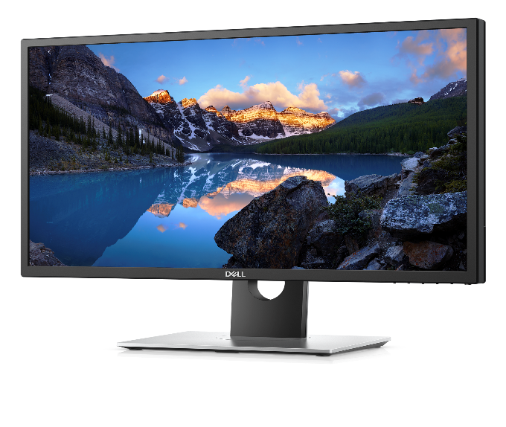

Back to Table of Contents
Dell Monitors
Innovative by design.
Notes:
*SOURCE: IDC and Forrester Business Technographics, Global Devices and Security Workforce Survey, 2015

Slide 12
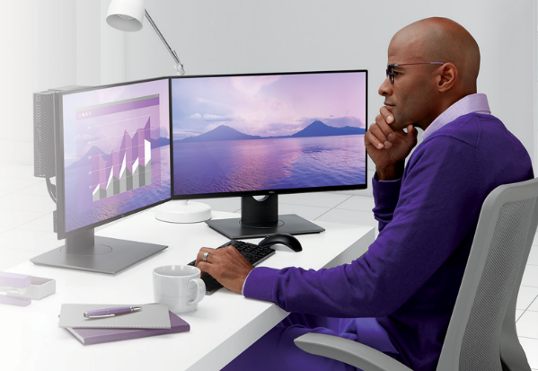
Back to Table of Contents
Why Dell: Monitors
1
World’s #1 monitor brand*: 17.6% market share
(16 consecutive quarters share growth), +12% Y/Y revenue growth.
2
A fistful of firsts: World’s first 31.5” 8K monitor, professional-level HDR monitor, 23.8” & 27” monitors with super thin borders on all 4 sides, and wireless monitors that connect to 2 devices with no wires.
3
Be more productive: Boost productivity up to 18% with narrow bezel design, 43” multi-client, curved, touch, video-conferencing with Skype for Business, Hello & Cortana, interactive large format.
4
Choose from the best: Broad portfolio that includes large range of sizes & resolutions, covering mainstream to power user to industry-specific needs, from desktop to conference room settings.
5
Rely on Dell Monitors: Dell’s Premium Panel Guarantee and Advanced Exchange Service assure peace of mind & minimize downtime.
Did you know?
Dual monitors can boost productivity by up to 18% vs. single monitors.
81%
of workers use a desktop for at least half their day.
*Dell monitors are #1 worldwide for 4 consecutive years (2013 to 2016). Source: IDC Worldwide PC Monitor Tracker (4Q16).

Slide 13
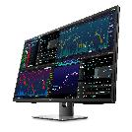
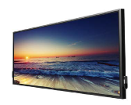

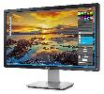


Dell Monitor Family
Back to Table of Contents
Dell UltraSharp
Dell Monitors
Dell UltraSharp Monitors
P Models
E Models
Large Format
Monitors
Specialty Monitors
A revolutionary viewing experience with uncompromising performance and innovative design
Reliable and environmentally efficient monitors with productivity boosting features, built for everyday business needs
Collaborate clearly with Dell Large Format Monitors
Specialized content viewing for key market segments like medical and financial
Award-winning high performance choices
Color precision
Brilliant screen resolution
Innovative product design
Essential features for productivity
Choices for all budgets
Eco-conscious materials with energy-efficient features
Superb reliability
Sharp details with easy viewing
Ideally sized for conference rooms seating up to 20 people
Easy set up
Compatible with most PCs
Interactive touch options
Medical Review monitors for reviewing patient records
Multi-Client monitor for viewing data from up to four client sources on one screen

Slide 14




Dell Monitors – Use Cases
Back to Table of Contents
Designed for the way you work
Desk Centric | Corridor Warrior | Remote | On-the-Go
Make efficient use of space (often small cube/setup) Comfortable set up (stationary for long periods) Large/dual monitor for productivity(often data heavy roles). | Seamless transition from desk to meetings Present/share info in meetings Connectivity on the go Convenient connections at their desk. | Connectivity to the core office (via telephone/video conference) Access to information (cloud, VPN) on the go Ability to be self-sufficient (including printing) Access to extra IT Support | Convenient, lightweight, portable devices Connectivity on the go Access to information (cloud, VPN) on the go Power on the go.
Multi – tasker in finance department, customer support, executive assistant. | High level executive, marketing manager who may travel, warehouse manager. | Territory manager, medical sales, remote events manager, help desk support. | Managers, insurance adjustors, field engineers.
Wide format monitors, or dual displays | [example] Convertible or detachable devices that make it easy to convert from tablet to laptop mode for presenting and developing content. Latitude 5285, 5289 and 7280 | Flexible based on the specific number of times the device needs to be carried or if legacy connections are needed. Latitude 5280, 5480, 7280, 7480 | NA
Task
User
Device

Slide 15


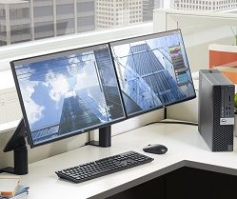
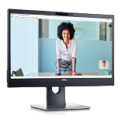
Dell Monitors – Sell dual and help boost productivity by 18%
Back to Table of Contents
Dell monitors help users see more and do more – clearly – with a wide open view and effortless usability.**
A view without borders
Virtually borderless design
Set up multiple monitors for an open view & expanded screen real estate great for multi-tasking
Dual monitor users are 18% more productive***
Dual monitor users are 91% more satisfied
Connect fast – use for hours
Broad connectivity options
TUV-certified flicker-free screen with ComfortView
  Optimizes eye comfort; minimizes blue light emission
*Dell monitors are #1 worldwide for 4 consecutive years (2013 to 2016). Source: IDC Worldwide PC Monitor Tracker (4Q16).
**Not unique to Dell.
***Source: Improving Employee Productivity with Dual Monitors, IDC InfoBrief, sponsored by Dell, November 2015.

Slide 16
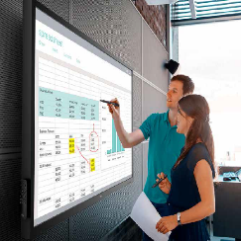
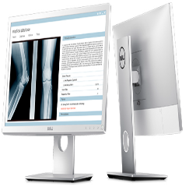
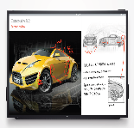

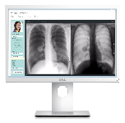
Dell Monitors – Large format & specialty monitors aid group collaboration & specialized viewing
Back to Table of Contents
From conference rooms to medical offices to trading floors - large format & specialty monitors make ideas and images clear.
Collaborate seamlessly
Impressive visuals – impactful presentations on sizes up to 86”
Easy collaboration with touch interactivity**
Easy installation and manageability
Review special content clearly
Medical review monitors meet requirements for clinical review
Boost productivity with side-by-side or quad-screen viewing on a 43” screen
*Dell monitors are #1 worldwide for 4 consecutive years (2013 to 2016). Source: IDC Worldwide PC Monitor Tracker (4Q16).
**Select models

Slide 17
Dell UltraSharp Monitors
Back to Table of Contents

Slide 18
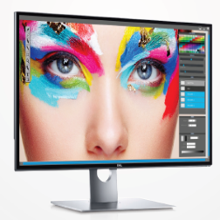
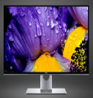
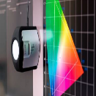

Dell UltraSharp Monitors – Visuals that rival real life
Back to Table of Contents
Dell UltraSharp monitors offer innovative, high performance Ultra HD resolution, Dell PremierColor and HDR10 – key tools a user needs to tackle highly detailed, color-critical jobs.
Ultra HD reality at your fingertips
Work with smooth color gradation and extremely realistic images – up to 8x Full HD
Capture every detail up to 4x Full HD with 4K resolution
Demanding work deserves Dell UltraSharp monitors
Detailed images with Ultra HD 4K & 8K resolution and high pixel density
Ideal color coverage & accuracy with Dell PremierColor**
Rich colors, enhanced contrast, brilliant texture & details – view and edit HDR10 content
Dell PremierColor
Broad color coverage, depth and gamut
Color precision from the start; calibrate to the desired color palette
HDR10 content
Incredible realism with high brightness – 3x brighter than today’s SDR displays – deepest blacks/brightest whites
High color fidelity for color-critical post-production
Remarkably clear with high 20,000:1 contrast ratio
*Dell monitors are #1 worldwide for 4 consecutive years (2013 to 2016). Source: IDC Worldwide PC Monitor Tracker (4Q16)
** Unique to Dell.

Slide 19

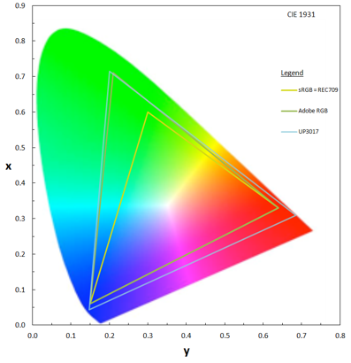
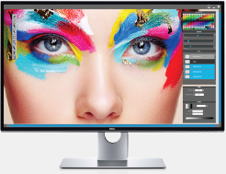
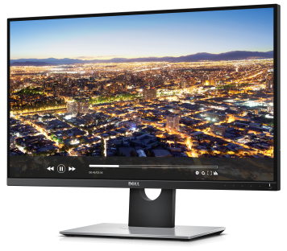
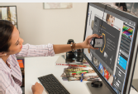
The Dell UltraSharp PremierColor Advantage
Back to Table of Contents
Dell PremierColor helps set the standard for color professionals, offering consistent, accurate colors right out of the box, powerful calibration capabilities, incredible color depth and wide color gamut – all the tools power users need for color-critical projects.
Ideal customers:
Photographers, videographers, graphic designers, commercial printing companies, and those whose work depends on accurate color.
Amazingly wide color coverage
Meets major industry standards, such as AdobeRGB, sRGB, Rec. 709, DCI-P3, for a broad spectrum of immaculate, unwavering colors. This gives users the flexibility
to choose their own color standard for color-critical
projects.
User-enabled color adjustments
Fine-tune colors using the
Custom Color mode, or make
further adjustments with the
user-accessible hardware
look-up table (LUT). Users
can calibrate the monitor in-house using a variety of tools or adjust color parameters according to their proprietary color solution with the SDK.
Incredible color depth and
color gamut
High level of detail–even in
dark areas–with a color depth of 1.07 billion colors. That’s 64 times more color
depth than standard monitors for better color gradation and precision in more shades
or colors.
Precise color, out of the box
Each monitor is factory color calibrated on AdobeRGB and sRGB to a Delta-E < 2 and comes with a complete factory calibration report, giving users the confidence that colors will be impressively accurate right from the start.
Dell UltraSharp Color Calibration Solution software is available on www.Dell.com/support
The X-Rite i1Display Pro colorimeter is available in selected countries for purchase from Dell. Contact a Dell representative to find out if it is available in your country. i1Display Pro is also available from X-Rite’s North American and Pantone online stores, and also from X-Rite's worldwide network of resellers.

Slide 20

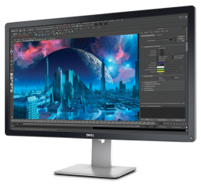

Dell UltraSharp 32 Ultra HD 4K Monitor with PremierColor – UP3216Q
Back to Table of Contents
Ideal PremierColor coverage and Ultra HD 4K clarity for every color professional.
Why did we create this product? To reinforce Dell’s leadership with UltraSharp monitors with a disruptively priced Ultra HD resolution, high color performance monitor To gain a large following of power users with innovative, cutting edge screen technology |  |  | Recommended Accessories Dell Soundbar – AC511 X-Rite i1Display Pro Colorimeter Dell Premium Lock – LP500
Ideal for whom? Professionals working on color-critical projects For more information click here to access the Monitors page on SalesEdge
Key features |  | Why it matters
Dell PremierColor | Experience wide 99% AdobeRGB, 100% sRGB color coverage with a deltaE<2 | Provides those professionals working on color-critical projects with the ideal tools they need to do their best work. Colors appear vivid, vibrant and true-to-life – highly accurate and extremely close to what you see around you. Precise colors are available immediately upon set up – no special calibration to access them.
Customizable color palettes |  | Convenience and availability of customization means users can save the palettes they need for special projects as needed.
Ultra HD 4K resolution | View more content and details onscreen | With Ultra HD 4K resolution (3840 x 2160 at 60 Hz), view more content and details onscreen – over 6 million more pixels than Full HD – over 8 million pixels of creativity to view, so every subtle nuance can be seen and animated.
HDMI 2.0/MHL 2.0 connectivity | 4K images can be transferred at 60 Hz | Provides uncompromising picture quality.
In-plane switching technology | Colors remain consistent across an ultra-wide viewing angle | Everyone can see accurate colors and images when collaborating around your desk
Premium Panel Guarantee, 3-Years Advanced Exchange Service | Support you can rely on. | In the event you discover even one bright pixel during the Limited Hardware Warranty period, a free panel exchange is guaranteed.
Product availability may vary by country.

Slide 21
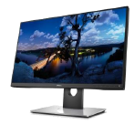
Dell UltraSharp Monitors with PremierColor: UP2716D / UP2516D
Back to Table of Contents
Ideal PremierColor coverage for every color professional.
Why did we create this product? Drive margin contribution to the Dell monitor portfolio Elevate competitiveness of Dell UltraSharp Monitors with PremierColor with improved color specs and manageability, narrow bezel design and QHD resolution |  |  | Recommended Accessories Dell Soundbar – AC511 X-Rite i1Display Pro Colorimeter Dell Premium Lock – LP500
Ideal for whom? Professionals working on color-critical projects For more information click here to access the Monitors page on SalesEdge
Key features |  | Why it matters
Dell PremierColor | Experience wide 99% AdobeRGB, 100% sRGB color coverage with a deltaE<2 | Colors appear vivid, vibrant and true-to-life – highly accurate and extremely close to what you see around you. Precise colors are available immediately upon set up – no special calibration to access them.
Customizable color palettes |  | Convenience and availability of customization means users can save the palettes they need for special projects as needed.
QHD resolution and ultra-wide viewing angle | Great for collaboration and sharing screen. | Outstanding screen clarity with QHD resolution, while ultra-wide viewing angle means colors are consistent from virtually any angle.
SDK (Software Development Kit) | Customize Dell UltraSharp monitors to preferred in-house custom color system | Easily manage color space and control video layout.
KVM (Keyboard, video, mouse) |  | View applications between two PCs simultaneously on one screen and manage content with just one keyboard and mouse.
Ultra-thin bezel design |  | Great for multi-monitor set-up so popular with designers.
Premium Panel Guarantee, 3-Years Advanced Exchange Service | Support you can rely on. | In the event you discover even one bright pixel during the Limited Hardware Warranty period, a free panel exchange is guaranteed.
Product availability may vary by country.

Slide 22
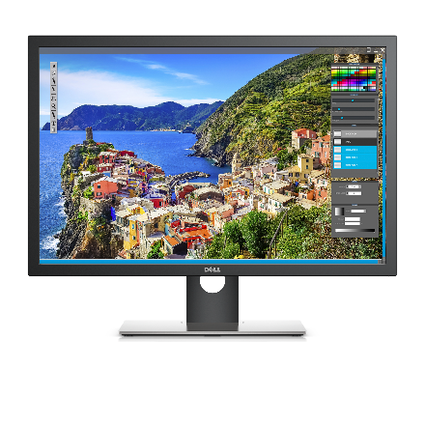
Dell UltraSharp Monitors with PremierColor: UP3017* / U2413 (US only)
Back to Table of Contents
Ideal PremierColor coverage for every color professional.
Why did we create this product? To meet the demands of creative professionals who need a large screen with great color coverage and accuracy for their color-critical work |  |  | Recommended Accessories Dell Soundbar – AC511 X-Rite i1Display Pro Colorimeter Dell Premium Lock – LP500
Ideal for whom? Professionals working on color-critical projects For more information click here to access the Monitors page on SalesEdge
Key features |  | Why it matters
Dell PremierColor | Experience wide 99% AdobeRGB, 100% sRGB color coverage with a deltaE<2 | Colors appear vivid, vibrant and true-to-life – highly accurate and extremely close to what you see around you. Precise colors are available immediately upon set up – no special calibration to access them.
Customizable color palettes |  | Convenience and availability of customization means users can save the palettes they need for special projects as needed.
Ultra-wide viewing angle | Great for collaboration and sharing screen. | Ultra-wide viewing angle means colors are consistent from virtually any angle
UP3017: WQXGA resolution | Crystal clear, high resolution images | UP3017 has 2560 x 1600 WQXGA resolution and a 16:10 aspect ratio, providing superb resolution on an expansive 30 inch screen.
Premium Panel Guarantee, 3-Years Advanced Exchange Service | Support you can rely on. | In the event you discover even one bright pixel during the Limited Hardware Warranty period, a free panel exchange is guaranteed.
*
Product availability may vary by country.

Slide 23
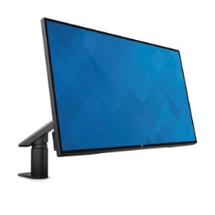
Dell UltraSharp InfinityEdge Monitors with Arms: U2717DA / U2417HA
Back to Table of Contents
The world’s first InfinityEdge Monitors with arms optimize your view and workspace.
Why did we create this product? Meet customer demands for better productivity with monitors that maximize desk space and optimize their viewing experience. |  |  | Recommended Accessories Dell Dual Monitor Stand – MDS14A (only applies to U2417HA) Dell 2.1 Bluetooth Speaker System – AC411 Dell Professional Stereo Headset – UC300 Dell Premium Lock – LP500
Ideal for whom? Large enterprise and SMB end users For more information click here to access the Monitors page on SalesEdge
Key features |  | Why it matters
World’s first InfinityEdge monitor with arm | Super thin borders on all four sides and an arm to support the monitor | Super thin borders on all four sides optimize your view. Single-arm arm mounting frees up desk space directly in front of the screen for writing and referencing, and provides greater viewing flexibility with versatile adjustability options.
Integrated cable management system | Hides cables from view | Keeps work space clutter-free by eliminating cable clutter.
Wide 99% sRGB color coverage with a deltaE<2 | Accurate colors | Accurate colors that are close to what you see around you.
QHD resolution (U2717DA only) | 1.77 times more screen details than with Full HD | Clearer, sharper screen images with QHD resolution than with Full HD.
In-plane switching technology | Colors remain consistent across an ultra-wide viewing angle | Everyone can see accurate colors and images when collaborating around your desk
Broad connectivity options | HDMI 1.4 (MHL 2.0), DP 1.2, mini-DP 1.2, DP-out, USB 3.0 x 4, Audio line-out | Allows daisy-chaining which promoted productivity-boosting multi-monitor arrangements, plus conveniently provides available ports for multiple secondary devices.
Premium Panel Guarantee, 3-Years Advanced Exchange Service | Support you can rely on. | In the event you discover even one bright pixel during the Limited Hardware Warranty period, a free panel exchange is guaranteed.
Product availability may vary by country.

Slide 24
Dell UltraSharp InfinityEdge Monitors with Arms: U2717D / U2417H
Back to Table of Contents
The world’s first InfinityEdge Monitors optimize your view with super thin borders on all sides.
Why did we create this product? To meet customer demands for a better viewing experience especially in a multi-monitor set up. |  |  | Recommended Accessories Dell Dual Monitor Stand – MDS14A (only applies to U2417HA) Dell 2.1 Bluetooth Speaker System – AC411 Dell Professional Stereo Headset – UC300 Dell Premium Lock – LP500
Ideal for whom? Large enterprise and SMB customers. For more information click here to access the Monitors page on SalesEdge
Key features |  | Why it matters
World’s first InfinityEdge monitor | Super thin borders on all four sides | Optimizes your viewing area
Wide 99% sRGB color coverage with a deltaE<2 | Accurate colors | Accurate colors that are close to what you see around you.
QHD resolution (U2717D only) | 1.77 times more screen details than with Full HD | Clearer, sharper screen images with QHD resolution than with Full HD.
In-plane switching technology | Colors remain consistent across an ultra-wide viewing angle | Everyone can see accurate colors and images when collaborating around your desk
Broad connectivity options | HDMI 1.4 (MHL 2.0), DP 1.2, mini-DP 1.2, DP-out, USB 3.0 x 4, Audio line-out | Allows daisy-chaining which promoted productivity-boosting multi-monitor arrangements, plus conveniently provides available ports for multiple secondary devices.
Premium Panel Guarantee, 3-Years Advanced Exchange Service | Support you can rely on. | In the event you discover even one bright pixel during the Limited Hardware Warranty period, a free panel exchange is guaranteed.
Product availability may vary by country.

Slide 25
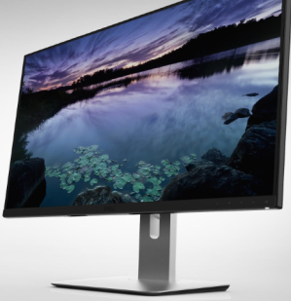
Dell UltraSharp Monitors with Ultra-Thin Bezels:
U2515H / U2415
Back to Table of Contents
Virtually borderless viewing ideal for a multi-monitor set-up.
Why did we create this product? These monitors were all refreshes of existing Dell UltraSharp monitors with enhanced features to improve user experience with better resolution, a much thinner bezel, wider color coverage, better connectivity and usability relative to any of their predecessors. |  |  | Recommended Accessories Dell Dual Monitor Stand – MDS14 (for U2415 and U2414H) Dell Single Monitor Arm – MSA14 Dell Soundbar – AC511 Dell Premium Lock – LP500
Ideal for whom? Power User/ Knowledge Workers For more information click here to access the Monitors page on SalesEdge
Key features |  | Why it matters
Ultra-thin bezels | Ultra-thin bezels on 3 sides | Delivers a nearly borderless view in multi-monitor set ups
99% sRGB color coverage with a deltaE<3 (U2715H, U2515H, U2415) deltaE<4 (U2414H) | Accurate colors | Accurate colors that are close to what you see around you.
Fully adjustable | Pivot, swivel, tilt and height-adjustable stand | Work the way you like – adjust the monitor to your ideal viewing position.
In-plane switching technology | Colors remain consistent across an ultra-wide viewing angle | Everyone can see accurate colors and images when collaborating around your desk
Comprehensive digital connectivity options | Including DisplayPort 1.2, Mini-DisplayPort, HDMI/MHL and high current charging port. | DP 1.2 allows daisy-chaining which promoted productivity-boosting multi-monitor arrangements, plus multiple connectivity ports means you can connect seamlessly to various secondary devices. High current charging port supplies twice the power for charging and powering BC 1.2 devices.
Premium Panel Guarantee, 3-Years Advanced Exchange Service | Support you can rely on. | In the event you discover even one bright pixel during the Limited Hardware Warranty period, a free panel exchange is guaranteed.
*
Product availability may vary by country.

Slide 26
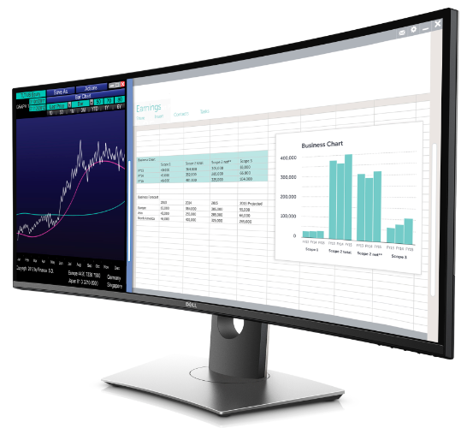
Dell UltraSharp 34 Curved Monitor – U3417W
Back to Table of Contents
Immersive display. Immaculate performance.
Why did we create this product? To address customers’ desire for ultra wide screen with an even more immersive experience. |  |  | Recommended Accessories Dell Keyboard and Mouse – KM714 Dell Professional Stereo Headset – UC300 Dell Premium Lock – LP500
Ideal for whom? Business executives and discerning professionals with large desks, working with multiple applications For more information click here to access the Monitors page on SalesEdge
Key features |  | Why it matters
Increased screen curvature | Optimized field of view, minimized reflection and near uniform visual focus. | More comfortable viewing of office apps across a curved screen. Panoramic wrap-around view for enhanced entertainment.
99% sRGB color coverage at small deltaE<2 | Precise colors right out of the box. | Easy to set up and get accurate colors right away – less involvement from IT, get working faster, see precise color
WQHD 3440x1440 screen and ultrawide viewing angle | More details and consistent colors. | Outstanding screen clarity for clear, sharp views every time.
ComfortView and flicker-free screen | Minimizes blue light emissions | Optimizes eye comfort.
21:9 aspect ratio with a huge 34” screen with powerful, dual 9W speakers | See more, hear more | Experience incredible depth, breadth and a wrap-around view and sound for an immersive experience.
Dell Easy Arrange, Picture-in-Picture and Picture-by-Picture with KVM | Customize screen layout, tile apps and view side-by-side. | Multitask with ease to help boost productivity – work effortlessly between applications and display content from two PC sources on one screen with only one keyboard and mouse.
Adjustability features | Tilt, swivel and height-adjustable stand – VESA-compatible mounting | Adjust your monitor to suit your needs so you can work the way you like, comfortably.
Premium Panel Guarantee, 3-Years Advanced Exchange Service | Support you can rely on. | In the event you discover even one bright pixel during the Limited Hardware Warranty period, a free panel exchange is guaranteed.
Product availability may vary by country.

Slide 27
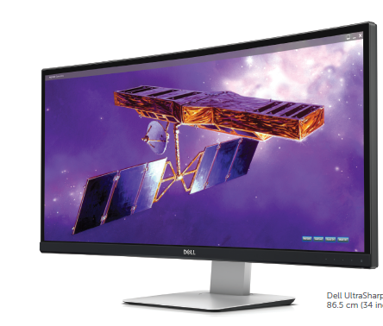
Dell UltraSharp 34 Curved Monitor – U3415W
Back to Table of Contents
Panoramic viewing takes multitasking to a whole new level.
Why did we create this product? To address customers’ desire for ultra wide screen with an immersive experience. |  |  | Recommended Accessories Dell Keyboard and Mouse – KM714 Dell Professional Stereo Headset – UC300 Dell Premium Lock – LP500
Ideal for whom? Business executives and discerning professionals with large desks, working with multiple applications Gamers and game developers For more information click here to access the Monitors page on SalesEdge
Key features |  | Why it matters
U3415W offers curved 21:9 aspect ratio with a 34” screen | Ideal monitor size for optimal viewing | With a wide, curved screen for more comfortable viewing, the U3415W offers an immersive, panoramic view with a wraparound feel. Dual integrated 9W speakers augment the immersive experience,.
WQHD 3440x1440 screen and ultrawide viewing angle | More details and consistent colors. | Outstanding screen clarity for clear, sharp views every time. U3415W is ideal alternative for dual monitors – sharper image with 20% more pixels than two Full HD monitors.
Variety of connectivity ports | mini DisplayPort, HDMI 2.0, multiple USB ports, and audio line out | Picture-by-Picture and Picture-in-Picture features a huge 34” display (thanks to HDMI 2.0)
Picture-by-Picture and Picture-in-Picture features |  | Navigate across multiple applications from 2 different PCs
Premium Panel Guarantee, 3-Years Advanced Exchange Service | Support you can rely on. | In the event you discover even one bright pixel during the Limited Hardware Warranty period, a free panel exchange is guaranteed.
Product availability may vary by country.

Slide 28
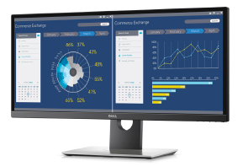
Dell UltraSharp 29 Ultra Wide Monitor – U2917W
Back to Table of Contents
Help boost productivity and multitask easily
Why did we create this product? To meet increasing demand for large ultra wide monitors, especially in financial sector where the 29” 21:9 monitor is becoming the new standard. |  |  | Recommended Accessories Dell Keyboard and Mouse – KM714 Dell Soundbar – AC511 Dell Premium Lock – LP500
Ideal for whom? Finance, sales and marketing, mid-level professionals, engineers, IT staff, programmers For more information click here to access the Monitors page on SalesEdge
Key features |  | Why it matters
Dell Easy Arrange, Picture-in-Picture and Picture-by-Picture | Work effortlessly between applications and display content from two PC sources on one screen | Boost productivity with efficient multitasking
21:9 aspect ratio with a 29” screen | More content fits on a single monitor | See more content easily on a single monitor to replace the equivalent of two 5:4 aspect ratio (1280 x 1240 resolution) monitors side by side.
Ultra-thin borders |  | Enables a clean, expansive dual monitor set-up
WQHD 2560 x 1080 screen with ultrawide viewing angle | More details and consistent color | Outstanding screen clarity across a wide viewing angle
ComfortView and flicker-free screen | Minimize blue light emissions | Experience easier, more comfortable viewing.
99% sRGB and 99% REC709 color coverage at small deltaE<2 | Accurate, true-to-life colors right out of the box. | Easy to set up and get accurate colors right away – less involvement from IT, get working faster, see precise color
Broad offering of connectivity ports | including USB 3.0 ports on the side of the monitor | Convenient connectivity to multiple devices. Easy access to USB ports.
Adjustability features | tilt, swivel and height-adjustable stand – VESA-compatible mounting | Adjust your monitor to suit your needs so you can work the way you like, comfortably.
Premium Panel Guarantee, 3-Years Advanced Exchange Service | Support you can rely on. | In the event you discover even one bright pixel during the Limited Hardware Warranty period, a free panel exchange is guaranteed.
Product availability may vary by country.

Slide 29
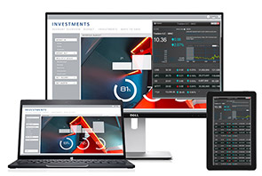
Dell UltraSharp 24 Wireless Connect Monitor – U2417HWi
Back to Table of Contents
World’s first monitor that allows two mobile devices to be connected wirelessly
Why did we create this product? To offer a convenient way to connect with two mobile devices without cables in the workplace and in turn respond to the growing user demand for more flexible connectivity. |  |  | Recommended Accessories Dell Wireless Keyboard and Mouse – KM714 Dell Dual Monitor Stand – MDS14 Dell Single Monitor Arm – MSA14 Dell Premium Lock – LP500
Ideal for whom? Small business For more information click here to access the Monitors page on SalesEdge
Key features |  | Why it matters
Wireless freedom | Wire-free, worry-free, hassle-free | Wire-free: Connect mobile devices to the monitor without wires Worry-free: No more need to find the right connectivity or cable Hassle-free: Set up once, then connect every time.
Display content from a Windows laptop and Android mobile device wirelessly | Display content from both mobile devices on the monitor, then edit with just one keyboard and mouse | Increase productivity by improving multitasking and collaboration with easy transitions between multiple devices on a single monitor Collaborate across two mobile devices - (Windows laptop1 + Android smartphone/ tablet2) and single monitor, keyboard and mouse with ease. Seamlessly transition tasks between mobile devices and monitor
Full HD clarity and consistent colors across an ultra-wide viewing angle |  | Superb viewing experience.
Ultra-thin bezel | Almost borderless viewing | Optimizes the viewing area
Premium Panel Guarantee, 3-Years Advanced Exchange Service | Support you can rely on. | In the event you discover even one bright pixel during the Limited Hardware Warranty period, a free panel exchange is guaranteed.
Product availability may vary by country.

Slide 30
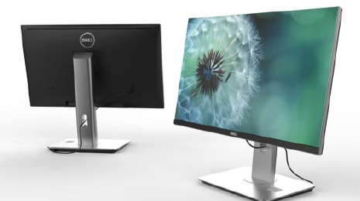
Dell UltraSharp 24 Monitor with Wireless Charging Stand – U2417HJ
Back to Table of Contents
Uncompromising performance with wireless charging convenience
Why did we create this product? To offer convenient wireless charging for Qi and PMA compatible smartphones and address increasing reliance of customers on smartphones. |  |  | Recommended Accessories Dell Dual Monitor Stand – MDS14A Dell Single Monitor Arm – MSA14 Dell Professional Stereo Headset – UC300 Dell Premium Lock – LP500
Ideal for whom? Small and medium businesses For more information click here to access the Monitors page on SalesEdge
Key features |  | Why it matters
Conveniently wireless device charging | Qi and PMA compatible smartphones without wires | Designed to help improve productivity and convenience by ensuring that your smartphone is always charged and ready.
Full adjustability | Tilt, pivot, swivel and height-adjustable stand | Adjust your monitor to suit your needs so you can work the way you like, comfortably.
Full array of connectivity options | DisplayPort (DP), mini-DP, DP-out, 2 x HDMI (MHL), 4 x USB3.0, Audio line-out | Convenient connection to your choice of secondary peripherals
Full HD with a wide viewing angle | Full HD and consistent colors across an ultra-wide viewing angle. Accurate colors and more than 96% sRGB color coverage | Delivers sharp, clear, vibrant images with accurate color.
Ultra-thin bezel | Almost borderless viewing | Optimizes the viewing area
Premium Panel Guarantee, 3-Years Advanced Exchange Service | Support you can rely on. | In the event you discover even one bright pixel during the Limited Hardware Warranty period, a free panel exchange is guaranteed.
Product availability may vary by country.

Slide 31
Dell Monitors — P Models and E Models
Back to Table of Contents

Slide 32
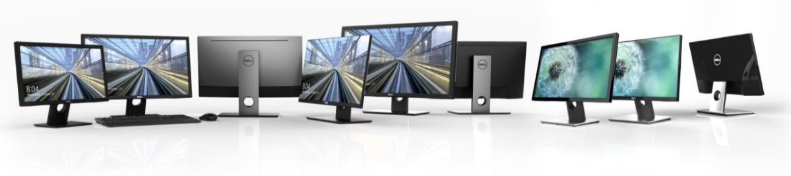






Dell Monitors
Reliable and environmentally efficient monitors with productivity-boosting features built for everyday work and play.
Essential features for productivity
Choices for your budget
Eco-friendly reliability
Models: MR, E, SE, S, P (including Touch)
Awards & Recognition
Discover if your customer needs a Dell monitor.
Basic questions to ask and words to listen for:
Dell 27 Ultrathin Monitor – S2718D
What type of work will you be using your monitor for?
What type of software applications do you use?
What do you need from your monitor?
Knowledge workers: Financial / administrative tasks, sales/ marketing presentations /reports
Task workers: Call centers, data manipulation and collection.
Educational institutions : Learning modules, classroom activities, language labs.
Healthcare organizations: Administration, clinical staff for viewing patient records, medical data and charts.
Home use for work applications, internet searching, research, movies and gaming.
Knowledge workers: Adobe Acrobat, Microsoft Office
Task workers: Microsoft Office
Educational institutions: Microsoft Office
Superb viewing experience including Ultra HD 4K and QHD for everyday use.
Accurate consistent colors with wide viewing angle.
Broad range of connectivity for peripherals, dual monitors , legacy PCs.
Flexible viewing options.
Medical monitor compliance.
Conference room options with better viewing quality.
Touch screen options.
Reliability with world-class warranty.
Dell 24 Touch Monitor – P2418HT
Dell Medical Review 24 Monitor – MR2416
Notes:
No high res images available

Slide 33
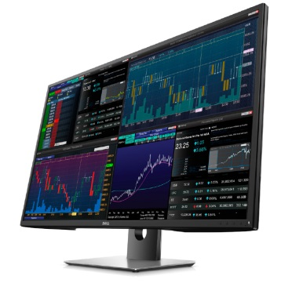
Dell 43 Multi-Client Monitor – P4317Q
Back to Table of Contents
View multi-client content in 43” Ultra HD clarity and enjoy simplified multi-monitor set-ups
Why did we create this product? To eliminate complex multi-monitor arrays with complex mounting issues and enable specialized users to work more productively with multiple screens in one simple array with no bezels in between. |  | Recommended Accessories Chief Kontour™ K2C Articulating Column Mount, 1 Monitor – K2C110B HumanScale M8 Dell Premium Lock – LP500
Ideal for whom? Financial market- trading desk workers; commercial/SMB – specialized uses such as code testing and web development. For more information click here to access the Monitors page on SalesEdge
Key features |  | Why it matters
Large 43” Ultra HD 4K or Full HD resolution with no bezel breaks | Large, clear viewing of the equivalent of four 22” monitors without interruption of bezels. 4K in single view, Full HD in quad view. | Multiple-monitor set up benefits without bezels, while still delivering high resolution images
Matte screen, monitor scalar |  | Comfortable large scale viewing.
Multiple client system connections | Connect up to four independent clients and view on one screen | Reduce complex multi-monitor mounting and connectivity issues.
In-plane switching technology | Colors remain consistent across an ultra-wide viewing angle | Everyone can see accurate colors and images when collaborating around your desk
Dell DisplayManager | Side-by-side and quad viewing, and simplified switching of content from one quadrant to another without IT assistance. | Manage how you see your content easily to maximize productivity
RS232 connectivity | Simplified remote IT management | Easy for your IT team to maintain and manage
One monitor vs four per desk | Easy cable management, optimized desk and relocation costs – standardized desk set-up | Simplified monitor purchasing, deployment and maintenance
Premium Panel Guarantee, 3-Years Advanced Exchange Service | Support you can rely on. | In the event you discover even one bright pixel during the Limited Hardware Warranty period, a free panel exchange is guaranteed.
Product availability may vary by country.

Slide 34
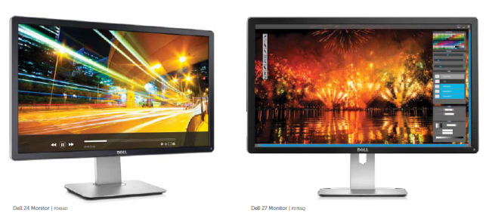
Dell Ultra HD 4K Monitors (P Models) ‒ P2715Q* / P2415Q
Back to Table of Contents
Exceptional Ultra HD 4K clarity at a reasonable price.
Why did we create this product? To offer 4K resolution to the mainstream user at a reasonable price. |  | Recommended Accessories Dell Single Monitor Arm – MSA14 Dell Dual Monitor Stand – MDS14 (for P2415Q only) Dell Sound bar – AC511 Dell Premium Lock – LP500
Ideal for whom? Professional photographers, publishers, engineering For more information click here to access the Monitors page on SalesEdge
Key features |  | Why it matters
Ultra HD 4K resolution | With Ultra HD 4K resolution (3840 x 2160 at 60 Hz), view more content and details onscreen – over 6 million more pixels than Full HD | Offers over 8 million pixels of creativity to view, so every subtle nuance can be seen and manipulated
99% sRGB at deltaE<3 | Wide color coverage for precise color rendering | Colors are precise, rich and true-to-life for vivid images
Flexible viewing options | Tilt, pivot, swivel and height-adjustable stand | Work the way you like – adjust the monitor to suit your needs and comfort
Wide array of connectivity options including MHL |  | Show content from smartphones and tablets on the larger monitor screen.
In-plane switching technology | Colors remain consistent across an ultra-wide viewing angle | Everyone can see accurate colors and images when collaborating around your desk
EasyArrange software |  | Helps you organize the monitor screen to view multiple apps at a glance.
Premium Panel Guarantee, 3-Years Advanced Exchange Service | Support you can rely on. | In the event you discover even one bright pixel during the Limited Hardware Warranty period, a free panel exchange is guaranteed.
*
Product availability may vary by country.

Slide 35
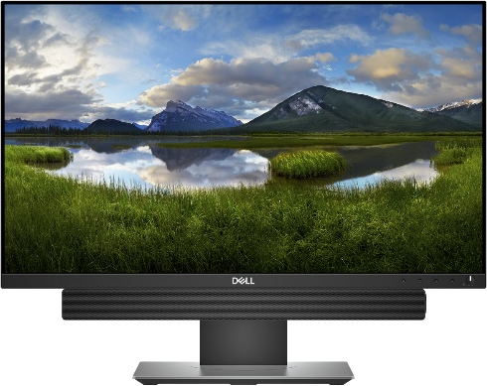
Dell 24 Monitor – P2418D
Back to Table of Contents
QHD clarity on a 23.8” monitor for mainstream users
Why did we create this product? To be one of the first monitor manufacturers to offer a 23.8” QHD resolution to the mainstream user. |  | Recommended Accessories Dell Single Monitor Arm – MSA14 Dell Sound bar – AC511 Dell Premium Lock – LP500
Ideal for whom? Office workers in commercial and SMB For more information click here to access the Monitors page on SalesEdge
Key features |  | Why it matters
Quad HD resolution | Remarkable clarity with QHD 2560 x 1440 screen resolution | See 1.77 times more details than Full HD for sharp, vibrant images
99% sRGB at deltaE<3 | Wide color coverage for precise color rendering | Colors are precise, rich and true-to-life for vivid images
Flexible viewing options | Tilt, pivot, swivel and height-adjustable stand | Work the way you like – adjust the monitor to suit your needs and comfort
Wide array of connectivity options | DisplayPort 1.2, HDMI 1.4, VGA, 4 USB 2.0 ports | Easily access content on peripheral devices
In-plane switching technology | Colors remain consistent across an ultra-wide viewing angle | Everyone can see accurate colors and images when collaborating around your desk
EasyArrange software |  | Helps you organize the monitor screen to view multiple apps at a glance.
Premium Panel Guarantee, 3-Years Advanced Exchange Service | Support you can rely on. | In the event you discover even one bright pixel during the Limited Hardware Warranty period, a free panel exchange is guaranteed.
Product availability may vary by country.

Slide 36
Dell 24 Touch Monitor – P2418HT
Back to Table of Contents
World’s best 24-inch Touch monitor** featuring unique articulating stand, anti-glare screen. The ultimate touch experience for business.
Why did we create this product? To offer innovative touch product with new Advanced In-Cell Touch technology and improved touch features to address customers’ needs and win over competition. |  | Recommended Accessories Dell 2.0 Speaker System – AE215 Dell Single Monitor Arm – MSA14 Dell Wireless Keyboard and Mouse Combo – KM636
Ideal for whom? Desk-centric worker and Corridor warrior For more information click here to access the Monitors page on SalesEdge
Key features |  | Why it matters
Anti-glare touch screen | Reduces distracting reflection and fingerprints | Improves visual clarity, resulting in a better visual experience
Unique articulating stand | Stand has height adjustment, extended tilt and swivel capabilities. | Allows the user to position the screen in the ideal position for touch navigation
Intuitive, 10-point touch, compatible with Windows® 10 |  | Provides smooth navigation across an edge-to-edge screen
Flicker-free screen and ComfortView | Minimizes blue light emissions | Delivers a more comfortable viewing experience
Cable management system and integrated power supply |  | Help reduce desk clutter
Full HD resolution, wide viewing angle, high dynamic contrast ratio | Superb screen clarity and consistent color across the screen. | Images are crisp and clear, with vibrant colors that are consistent from virtually any angle
Ultrathin bezels |  | More seamless view and workflow across multiple monitors.
Dell Easy Arrange and Auto Mode | Facilitates tiling of desktop applications to aid multitasking; allows for custom preset color settings to save time. | Multi-task and save time to get more done
Flexible mounting options, extensive connectivity |  | Users can adjust the monitors position for their comfort, and access ports easily
Premium Panel Guarantee, 3-Years Advanced Exchange Service | Support you can rely on. | In the event you discover even one bright pixel during the Limited Hardware Warranty period, a free panel exchange is guaranteed.
Product availability may vary by country.
**Disclosure –legally required for APJ, EMEA, LATAM only; not required for NA: Actual panel size of P2418HT is 23.8”. Based on Dell internal analysis of feature sets of competitive 23” and 24” touch monitors, August 2016

Slide 37
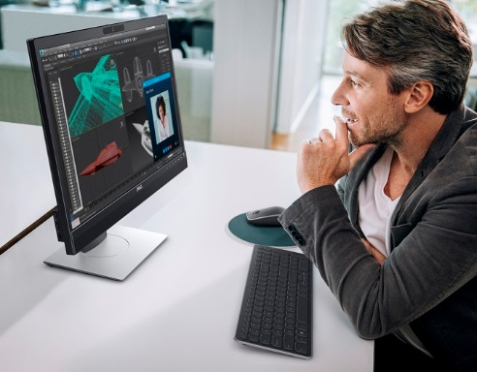
Dell 24 Monitor for Video Conferencing – P2418HZ
Back to Table of Contents
Enhanced desktop video conferencing – Microsoft® Skype® for Business, Windows Hello™ certified 23.8-inch monitor
Why did we create this product? Enhanced video conferencing experience vs. previous product to promote engaging communication and effective business collaboration. |  | Recommended Accessories Dell Pro Stereo USB headset – UC350 Dell Dual Monitor Arm – MDA17 Dell Wireless Keyboard and Mouse Combo – KM636
Ideal for whom? Remote worker needing right technology to stay connected; Desk-centric worker. For more information click here to access the Monitors page on SalesEdge
Key features |  | Why it matters
Built-in camera, microphone and speakers | Built-in 2 megapixel Full HD camera with privacy shutter, noise-cancelling microphone, dual 5W speakers | Improved collaboration for remote and desk-centric workers.
Certified to work with Microsoft Skype® for Business and Windows Hello |  | Enhanced desktop video conference experience. Windows Hello greets you by name and lights up in your presence.
Full HD screen, wide viewing angle | Superb screen clarity and consistent colors across the entire screen | Great visual experience for group conferencing
Windows Hello™ capable* | Secure facial authentication for Windows 10 device log-in. | Secure but easy to access -- Log-in, unlock and re-authenticate in as little as 2 seconds
Narrow bezels | Optimizes screen view | Ideal for dual monitor setup.
Full HD resolution, wide viewing angle, high dynamic contrast ratio | Superb screen clarity and consistent color across the screen. | Images are crisp and clear, with vibrant colors that are consistent from virtually any angle
Microsoft Cortana** digital assistant | Voice-activated digital assistant | Allows hands-free initiation of simple tasks
Dell Easy Arrange and Auto Mode | Facilitates tiling of desktop applications to aid multitasking; allows for custom preset color settings to save time. | Multi-task and save time to get more done
Flicker-free, anti-glare screen and ComfortView feature | Minimizes blue light emissions, image flickering and glare | Makes for a more comfortable view experience
Premium Panel Guarantee, 3-Years Advanced Exchange Service | Support you can rely on. | In the event you discover even one bright pixel during the Limited Hardware Warranty period, a free panel exchange is guaranteed.
Product availability may vary by country.
* Windows Hello requires specialized hardware, including fingerprint reader, illuminated IR sensor or other biometric sensors
** Cortana available in select global markets at launch. Cortana experience may vary by region and device

Slide 38
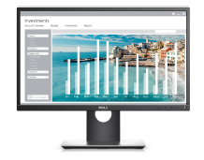
Dell Monitors (P Models)
Back to Table of Contents
The smart choice to help boost productivity with more comfort and convenience
Why did we create this product? Refreshed line-up to complement newer Dell laptops with HDMI in place of DVI ports and refresh to a new design. |  | Recommended Accessories Dell Sound Bar – AC511 Dell Single Monitor Arm – MSA14 Dell Dock with Monitor Stand – DS1000
Ideal for whom? Commercial – knowledge workers in all vertical markets. For more information click here to access the Monitors page on SalesEdge
Key features |  | Why it matters
Slim border design | Great for multi-monitor set up | Helps boost productivity with more viewing area
Dell Auto Mode | Efficiently allows users apply predefined color settings for various applications | Allows for increased productivity
In-plane switching technology (except P2217/ P2217Wh) | Colors remain consistent across an ultra-wide viewing angle | Everyone can see accurate colors and images when collaborating around your desk
Full set of viewing options | Tilt, pivot, swivel and height-adjustable stand | Adjust your monitor to suit your needs so you can work the way you like, comfortably
Flicker-free screen and ComfortView feature | Minimizes blue light emissions and image flickering | Makes for a more comfortable view experience
4 USB ports | Two USB 3.0 on the monitor side | Easy accessibility and convenience
Wide range of digital ports |  | Future-proof your connectivity and easily connect to variety of peripherals
Premium Panel Guarantee, 3-Years Advanced Exchange Service | Support you can rely on. | In the event you discover even one bright pixel during the Limited Hardware Warranty period, a free panel exchange is guaranteed.
*P2717H, P2417H, P2217H, P2217, P2016, P1917S
* Windows Hello requires specialized hardware, including fingerprint reader, illuminated IR sensor or other biometric sensors
Product availability may vary by country.

Slide 39
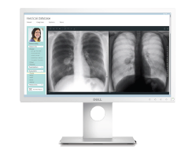
Dell 22 Medical Review Monitor – MR2217
Back to Table of Contents
Compact 21.5” DICOM calibrated medical review monitor built for efficient point of care use
Why did we create this product? Extend Dell’s monitor expertise into healthcare market.
Ideal for whom? For medical record and text review with physicians, nurses, specialists and other clinicians - Not designed or intended for use in primary medical image interpretation, diagnosis or active patient monitoring. For more information click here to access the Monitors page on SalesEdge
Key features |  | Why it matters
Conforms to DICOM part 14 standard | Great for multi-monitor set up | Superior viewing experience for clinical review — allows healthcare professionals to review images with same consistent image quality
Consistent grayscale images; backlight stabilization; matte screen; ultra-wide viewing | Efficiently allows users apply predefined color settings for various applications | Backlight stabilization ensures consistent brightness throughout life of monitor. Reduced glare-improved screen clarity. Consistent coloration from virtually any angle for improved collaboration.
Smooth, vent-less design | Minimizes direct trapped in grooves
Light-colored exterior | Consistent with infection control protocols | Allows for the easy detection of blood stains and contaminants, and it is easily cleanable
Monitor housing treated with antimicrobial additive | Meets medical design standards and safety requirements for medical electrical equipment | Housing protected from stains or deterioration caused by bacteria – wipe it down with standard cleaning products without damaging its coating
IEC 60601-1 compliant | Active screw-on clip 60 degree swivel/tilt, pivot and height-adjustment Mechanical power/OSD buttons VESA mount | Clip secures cables so they are not easily pulled/disconnected Allows easy sharing with patients/flexible viewing Mechanical buttons easy to find and use with gloves on Detach monitor from stand and easily mount on cart or wall
Compact 21.5” size |  | Ideal size for work station on wheels (WoW)
Premium Panel Guarantee, 3-Years Advanced Exchange Service; ISO13485 certified | Support you can rely on. | In the event you discover even one bright pixel during the Limited Hardware Warranty period, a free panel exchange is guaranteed. ISO certification to meet regulatory requirements for design, development and support of medical displays.
Product availability may vary by country.

Slide 40
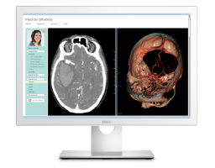
Dell 22 Medical Review Monitor – MR2416
Back to Table of Contents
Fully cleanable, DICOM calibrated, and aligned with infection reduction initiatives
Why did we create this product? Extend Dell’s monitor expertise into healthcare market.
Ideal for whom? For medical record and text review with physicians, nurses, specialists and other clinicians - not designed or intended for use in primary medical image interpretation, diagnosis or active patient monitoring. For more information click here to access the Monitors page on SalesEdge
Key features |  | Why it matters
Fully sealed with a protective covered glass and comes with an IP-32 rating (front and back) | Cleaning liquids with up to 75% of concentrated ethyl alcohol solution can be used to disinfect both the monitor’s surface and its glass panel. | Aligned with infection reduction initiatives.
Light-colored exterior | Easy detection of blood stains and contaminants | Allows for the easy detection of blood stains and contaminants, and it is easily cleanable
Conforms to DICOM part 14 standard; consistent grayscale images; backlight stabilization; anti-reflective coat on glass panel; ultra-wide viewing. | Minimizes direct trapped in grooves | Superior viewing experience - allows healthcare professionals to review images with same consistent image quality. Backlight stabilization ensures consistent brightness throughout life of monitor. Reduced glare-improved screen clarity. Consistent coloration from virtually any angle for improved collaboration.
Purpose built for challenging healthcare environment – IEC 60601-1 compliant | Active screw-on clip 60 degree swivel/tilt, pivot and height-adjustment Mechanical power/OSD buttons VESA mount | Improved healthcare efficiency. Meets medical design standards and safety requirements for medical electrical equipment. Clip secures cables so they are not easily pulled/disconnected. Swivel allows easy sharing with patients/flexible viewing. Mechanical buttons easy to find and use with gloves on. Detach monitor from stand and easily mount on cart or wall.
Premium Panel Guarantee, 3-Years Advanced Exchange Service; ISO13485 certified | Support you can rely on. | In the event you discover even one bright pixel during the Limited Hardware Warranty period, a free panel exchange is guaranteed. ISO certification to meet regulatory requirements for design, development and support of medical displays.
Product availability may vary by country.

Slide 41
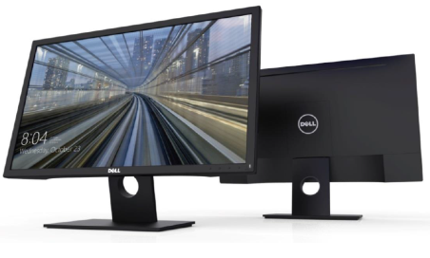
Dell Monitors (E Models)
Back to Table of Contents
Affordable and reliable monitors with essential features that drive productivity.
Why did we create this product? Refreshed line-up to support industry transition from VGA to DisplayPort connectivity. |  | Recommended Accessories Dell Wireless Keyboard & Mouse Combo – KM636 Dell Single Monitor Arm – MSA14 Dell Premium Lock – LP500
Ideal for whom? Task workers looking for affordable, reliable monitors with essential features for productivity. For more information click here to access the Monitors page on SalesEdge
Key features |  | Why it matters
Ultra-wide viewing angle (E2417H only) | Consistent colors across the entire screen | Great for collaboration and sharing screen
Flicker-free screen with ComfortView feature (E2417H only) | Minimizes blue light emissions and image flickering | Makes for a more comfortable view experience
Up to Full HD resolution with wide range of screen sizes | Superb screen clarity and details. Wide selection of screen sizes to fit your needs from 17” to 24” | See more with the resolution and size you need
Connectivity compatibility | Compatible with both legacy and current PCs via VGA and DisplayPort connectivity (ports vary by model) | Easily connect to a variety of computers
VESA mount compatibility |  | Use the monitor on its stand, on a monitor arm, or on the wall for viewing flexibility
Compliant with required environmental and regulatory requirements |  | Help your organization reduce its carbon footprint
3 Years Advanced Exchange Service and Limited Hardware Warranty |  | Support you can rely on
*E2417H, E2216H, E1916H
Product availability may vary by country.

Slide 42
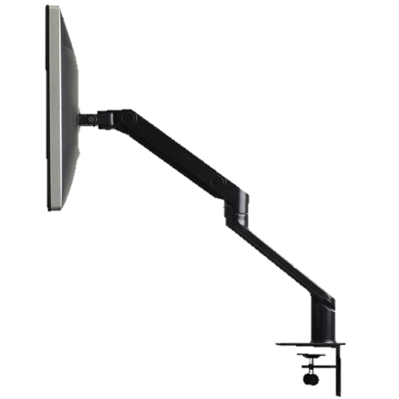
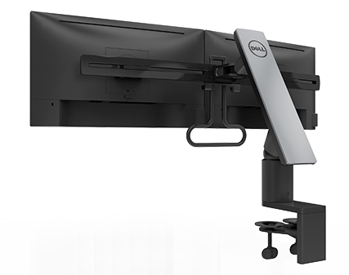
Monitors Arms
Back to Table of Contents
Dell Single Monitor Arm – MSA14 | Dell Dual Monitor Arm – MDA17
Why did we create this product? To offer customers an option for mounting monitors to free up desk space for a more clutter-free working area with a completely adjustable view for one or two monitors.
Ideal for whom? Knowledge workers and other commercial customers – anyone with a VESA-compatible monitor. For more information click here to access the Monitors page on SalesEdge
Key features | MSA14: Why it matters | MDA17: Why it matters
Multi-adjustment capabilities | Height adjustability, tilt, and swivel and pivot features maximize your viewing comfort and improve your productivity. | Users can adjust the monitors for more comfortable viewing. Monitors can be easily moved in unison or pivot individually up to 90 degrees clockwise or anti-clockwise. Articulation and tilt provides customizable positions and more comfortable viewing angles. The adjustable handle allows for easy one-handed movement of both monitors in unison. Double swivel functionality allows for 180 degree turning of both monitors so you can easily share content with your peers.
Easy set up | Simple snap to the VESA mount at the back of the monitor without the need for screws. The Dell Single Monitor Arm supports monitors that weigh up to 20.5 pounds. | The two adaptors provided on the arm can attach to any VESA compliant monitors
Keeps monitor off the desk, manages cable clutter | With the arm, the monitor is off of the desk surface, freeing up work space on the desk. When properly positioned, the integrated cable management feature keeps your desktop neat, offering both enhanced ergonomics and improved space utilization. | With the arm, the monitors are off of the desk surface, freeing up work space on the desk. An internal latch on the arm ensures that cables will be hidden from sight, freeing up space on your desk.
Tested and validated on Dell systems | It is supported by Dell Technical Support when used with a Dell system. | It is supported by Dell Technical Support when used with a Dell system.
Product availability may vary by country.

Slide 43
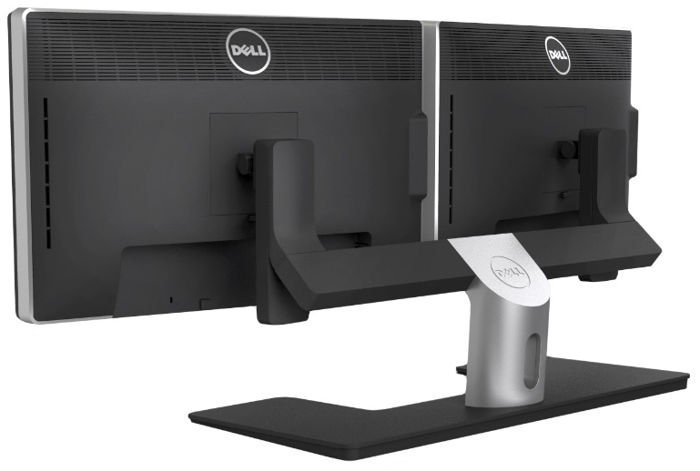
Dell Dual Monitor Stand – MDS14A
Back to Table of Contents
View content across two monitors
Why did we create this product? To offer customers an option for mounting two monitors to free up desk space for a more clutter-free working area.
Ideal for whom? Knowledge workers and other commercial customers – anyone with a VESA-compatible monitor. For more information click here to access the Monitors page on SalesEdge
Key features |  | Why it matters
Multi-adjustment capabilities | Tilt, swivel and horizontally slide the monitors on the stand | Maximize your optimal viewing comfort and improve your productivity
Easy set up | Two adaptors provided on the stand assure that the dual monitor stand can easily attach to any VESA-compliant monitor. This stand supports two monitors up to 24-inches in size. | Enjoy improved productivity
U-shaped base and integrated cable management |  | Frees up space on your desk surface, and keeps your workspace uncluttered of cables.
Tested and validated on Dell systems |  | It is supported by Dell Technical Support when used with a Dell system.
Product availability may vary by country.

Slide 44
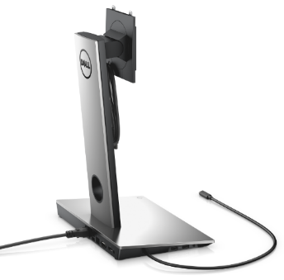
Dell Dock with Monitor Stand – DS1000
Back to Table of Contents
Integrated display stand and USB Type-C dock
Why did we create this product? To offer the convenience of single-cable USB Type-C connectivity for monitors which don’t ordinarily come with that connectivity.
Ideal for whom? Anyone needing a more simplified connectivity option who has a monitor with VESA-compatible stand currently. For more information click here to access the Monitors page on SalesEdge
Key features |  | Why it matters
Integrated Design with Superior Cable Management | Combines the display stand and features of the Dell Dock into a singular integrated device | The small size and single cable connectivity allows for easy placement within a workspace. Enables 1 power cable to the wall for dock and display.
Single cable connectivity | Easily connect your system to video, power and data using the single USB Type-C cable. Provides flexible display options through dual FHD displays or a single 4K UHD display at 30 Hz. Type-C connectivity is on the leading edge of data, power and video performance. Powers everyday peripherals (i.e. mice, smartphone, external storage) with 2 x USB 3.0 and 2 x USB 2.0 for added productivity and supports VESA quick release Dell E & P & UltraSharp series monitor (19" to 27"). | Enjoy improved productivity, with less cables cluttering the desk
One dock for all | Buy one model of dock for all of your compatible Dell notebooks and tablets. Universal docking solution with compatible non-Dell branded systems. | Frees up space on your desk surface, and keeps your workspace uncluttered of cables.
Product availability may vary by country.

Slide 45
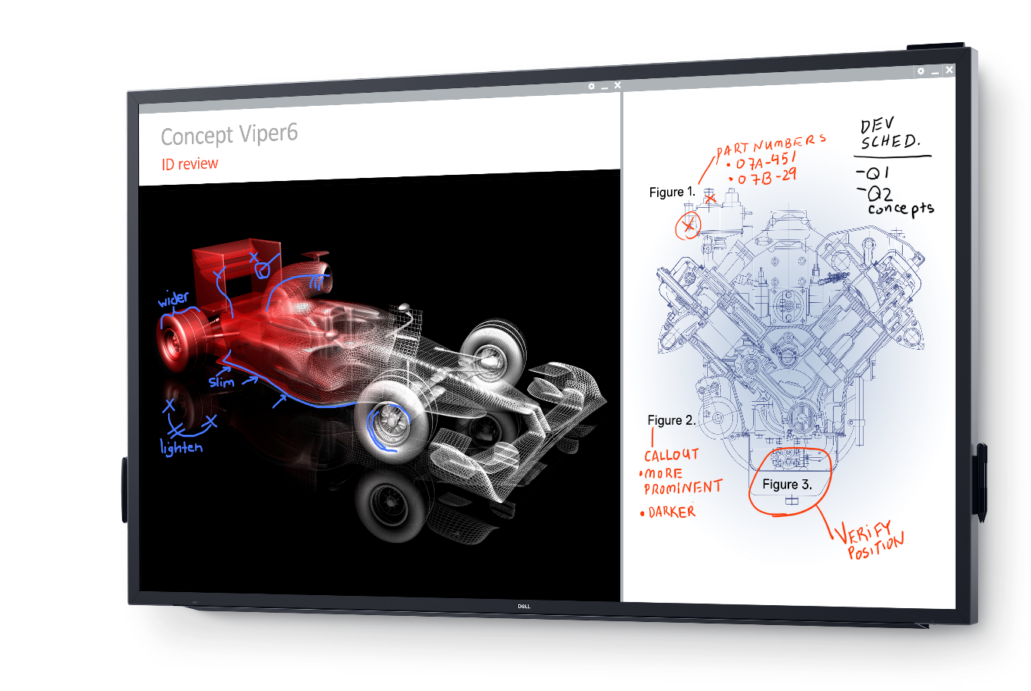
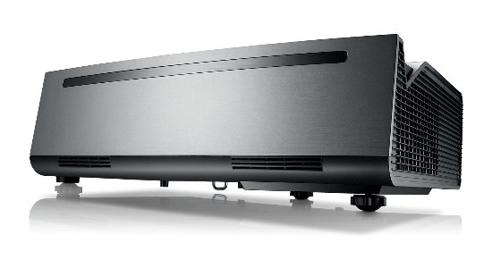
Back to Table of Contents
Dell Projectors & Conference Displays
Designed to fit your needs and budget.
Notes:
*SOURCE: IDC and Forrester Business Technographics, Global Devices and Security Workforce Survey, 2015

Slide 46
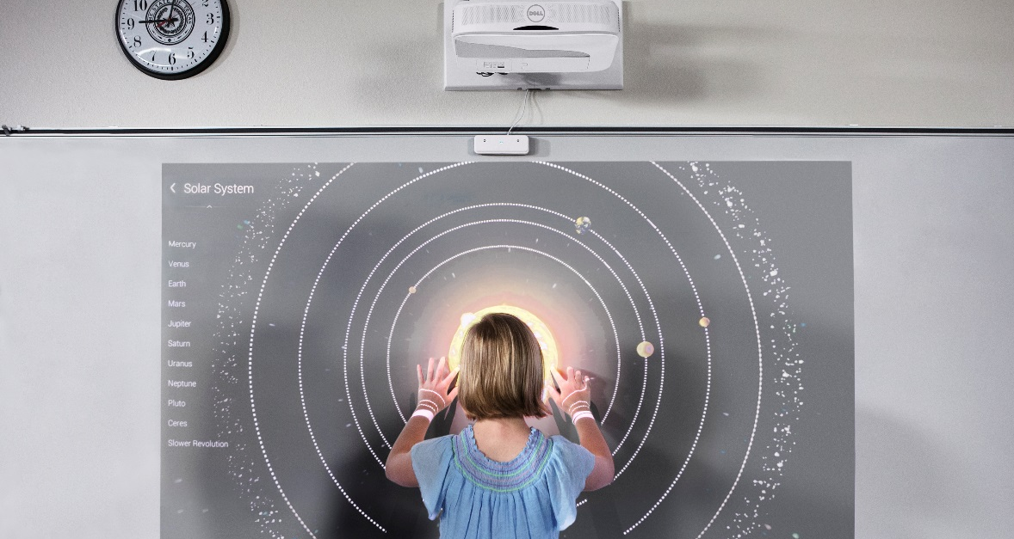

Back to Table of Contents
Why Dell: Projectors & Conference Room Displays
1
Comprehensive portfolio: Range of traditional, mobile, network, laser or interactive projectors and large format displays to fit your customers’ needs and budgets.
2
Easy to connect: Enhanced collaboration features and advanced connectivity options to laptops, tablets and other devices.
3
Simple deployment: Easy to deploy and use with enterprise-class security and world-class support.
4
Innovative technologies: A variety of innovative technologies, such as interactive touch, laser light sources, 4K ultra short throw capabilities.
5
Outstanding warranty: Advanced Exchange Service on projectors and large format monitors.

Slide 47
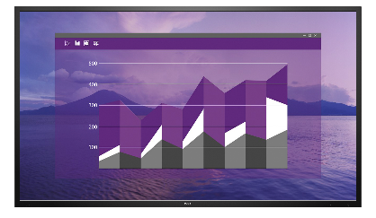
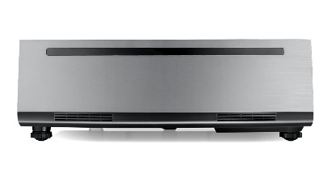
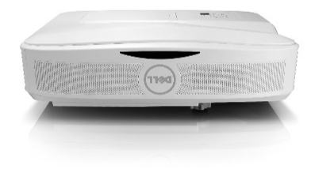



Dell Large Format Displays and Projectors
Engage audiences with excellent image quality, collaboration features, and connectivity options.
Large Format Displays
Professional Projectors
Advanced Projectors
Mobile Projectors
Interactive Projectors
Engage your audience in your next presentation with clear images and great collaboration features. | Designed for organizations that need affordable projectors with high quality essential features that maximize visual impact. | Deliver high quality presentations with crisp, bright projection, brilliant colors, and network management features. | Ideal for professionals on the go, Dell Mobile Projectors are compact, lightweight and portable. | Designed for classrooms and meeting spaces, interactive projectors help engage audiences.
Features in LFD portfolio: Full HD & 4K resolution Up to 20 points of touch on interactive displays Network management via RS232 and RJ-45 | Features in the Professional portfolio: SVGA to Full HD Resolution HDMI, VGA, Composite connectivity 4:3, 16:9, and 16:10 Aspect ratios | Features in the Advanced portfolio: Full HD & 4K resolution Low maintenance lamp-free Laser options Network management via RS232 and RJ-45 | Features in the Mobile portfolio: Onboard storage & USB input for PC free presentation Carrying case included Lamp-free LED technology | Features in the Interactive portfolio: Up to 10 points of touch on S560T Dual pen functionality on S560P Network management via RS232 and RJ-45
Models: C5517H, C7017T, C7016H, C5518QT, C8618QT | Models: 1450, 1550, 1650, 1850, P318S | Models: 4350, 7760, S560, S718QL | Models: M115HD, M318WL, M900HD | Models: S560P, S560T
*Dell monitors are #1 worldwide choice for 4 consecutive years. Source: IDC Worldwide PC Monitor Tracker (4Q16)

Slide 48
Where do Dell Large Format Displays fit?
Back to Table of Contents
 | Consumer TV | Dell Large Format Displays | Digital Signage
Built on monitor technology | Optimized for moving picture Glossy screen Overscan | Monitor Scalar provides clearer text & image Plug and Play with IT input device | Monitor scalar provides clearer text and image Cover glass designed for high ambient light environments Designed for use in portrait or landscape orientation Requires some type of content management software
Reliability | 8 hours operation per day 12 months warranty | 12-16 hours operation per day 3 years warranty and advanced exchange service | 16 to 24 hour operation per day Ruggedized/Outdoor models 3 year warranty
Connectivity | No RS232 or RJ45 support No DP or VGA | RS232 interface for remote IT manageability Free from wires (Wireless Ready) Better compatibility with IT devices (HDMI / MHL, DP, VGA and USB ) | RS232 and RJ45 Analog and digital connectivity options Embedded system
Global Support | Different model and specs by regions Carry in warranty | Global 1 product for G500 customers | Different models and specs per region Onsite NBD warranty depending on manufacture and model

Slide 49






Dell Conference Room Monitors
Back to Table of Contents
Share content in a small meeting room or conference room with a Dell Conference Room Monitor
C5517H
C5518QT
C7016H
C7017T
C8618QT
Diagonal Viewing Size | 54.6" (1386.84 mm) | 1397 mm (54.64 inch) | 1765.63 mm (69.513 inch) | 1765.63 mm (69.513 inch) | 2174 mm (85.6 inch)
Optimal Resolution | 1920 x 1080 at 60Hz | 3840 x 2160 at 60 Hz | 1920 x 1080 at 60 Hz | 1920 x 1080 at 60 Hz | 3840 x 2160 at 60 Hz
Aspect ratio | Widescreen (16:9) | Widescreen (16:9) | Widescreen (16:9) | Widescreen (16:9) | Widescreen (16:9)
Brightness (typical) | 350 cd/m² (typical) | 350 cd/m² (typical) | 400 cd/m² | 350 cd/m² (typical) | 400 cd/m² (typical)
Pixel Pitch | 0.21 mm (W) x 0.63 mm(H) | 0.315 mm x 0.315 mm | 0.802 x 0.802 mm | 0.802 x 0.802 mm | 0.4935 mm x 0.4935 mm
Color Support | 16.7 million colors | 1.07 billion | 1.07 billion | 1.07 billion | 1.07 billion
Contrast Ratio | 3000:1 (typical) | 1200:1 (typical) | 4000:1 (typical) | 4000:1 (typical) | 1200:1 (typical)
Viewing Angle | 178° vertical / 178° horizontal | 178° vertical / 178° horizontal | 176° vertical / 176° horizontal | 176° vertical / 176° horizontal | 178° vertical / 178° horizontal
Weight (panel only, VESA mount) | 44.9 lb (20.4 kg) | 116.84 lb (53 kg) | 39.0 kg (85.8 lb) | 55.5 kg (122.35 lb) | 264.55 lb (120 kg)
Response Time | 8 ms (grey to grey) | 8 ms (grey to grey) | 6 ms (GTG) with Overdrive | 6 ms (GTG) with Overdrive | 8 ms (grey to grey)
Display Screen Coating | Antiglare with hard-coating | Antiglare with hard-coating | Antiglare with hard-coating | Antiglare with hard-coating | Antiglare with hard-coating
Audio Output | Internal : 10W x2 | Internal : 10W x2 | Internal : 10W x2 | Internal : 10W x2 | Internal : 10W x2
Connectivity | VGA, 2 x HDMI, DisplayPort, RS232 port, Audio Line Out Port, Audio Line In Port, USB upstream port, 2x USB downstream port | 3 x HDMI 2.0, DisplayPort 1.2, VGA, Audio Input, Headphone Output, RJ 45, 3 x USB 3.0, USB dedicated charging port, RS232, USB 3.0 port – Upstream, 3 x USB 3.0 port, USB dedicated charging port | VGA, HDMI (vr1.4, MHL 2.0 combo) x2, DisplayPort 1.2 x1, USB 2.0 x3, Audio in, Audio out | VGA, 2x HDMI 1.4 (no MHL) and HDMI (MHL), DP (1.2, Audio in, Audio out, USB Ports, USB 2.0 for touch, 4 x USB 3.0 downstream port including a fast charging port | 4 x HDMI 2.0, DisplayPort 1.2, VGA, Audio Input, Headphone Output, RJ 45, 3 x USB 3.0, USB dedicated charging port, RS232, USB 3.0 port – Upstream, 3 x USB 3.0 port, USB dedicated charging port
Dimensions (without stand) | Height: 30.9" (786.0 mm) Width: 48.9" (1241.0 mm) Depth: 2.6" (64.8 mm) | Height: 30.9” (784.5 mm) Width: 51.1” (1298.6 mm) Depth: 3.56” (90.6 mm) | Height: 36.5” (926.6 mm) Width: 62.4” (1584.22 mm) Depth: 3.1” (79.1 mm) | Height: 36.7” (932.6 mm) Width: 62.7” (1593.5 mm) Depth: 3.7” (95.1 mm) | Height: 45.98” (1167.9 mm) Width: 78.6” (1996.3 mm) Depth: 3.99” (101.5 mm)

Slide 50

Dell 55 Conference Room Monitor – C5517H
Back to Table of Contents
55” of brilliance ideal for business meetings in a small conference room
Why did we create this product? Update of E5515H with added Dell Display Manager, wireless connectivity, remote manageability improvements. |  | Recommended Accessories Logitech ConferenceCam – CC3000e Chief Mobile Cart – LPAUB
Ideal for whom? Organizations needing improved way of displaying images and text for small group discussions, presentations and training sessions and who value the additional features of the C5517H. For more information click here to access the Projectors/LFD page on SalesEdge
Key features |  | Why it matters
Exceptional clarity | Anti-glare screen with Full HD 1920 x 1080 resolution | Microsoft Office applications like Excel and PowerPoint display beautifully.
Simple and convenient connectivity | DisplayPort, HDMI and VGA ports | Easy connectivity to most PCs for hassle-free presentations.
Great view from any angle | Colors remain consistent across a wide 178°/178° viewing angle | Everyone in the room gets the same great view.
Outstanding view | Optimized for fonts and keeps text sharp and clear | Content is easy for everyone in the room to see. Dell Display Manager software enables customized screen layouts.
Wireless display | Optional Dell Wireless Module - WR517, powered from a built-in USB port. | Wirelessly connect and share your content with the room.
Stress-free manageability | RS232 connection | Let your IT team manage and control the monitor remotely.
Flexible viewing | Display your monitor on the wall with an optional 400mm x 400mm VESA-compatible mounting kit | Mount the monitor in your conference room for a custom view.
3 Years Advanced Exchange Service and Limited Hardware Warranty |  | Support you can rely on.
Product availability may vary by country.

Slide 51

Dell 70 Conference Room Monitor – C7016H
Back to Table of Contents
The ideal large monitor for business meetings in a medium-sized conference room seating up to 12 people.
Why did we create this product? Extend offering of conference room monitors to a larger size for medium-sized conference rooms up to 12 people. |  | Recommended Accessories OptiPlex 7040 Micro PC with Intel® Unite™ Logitech C90e HD Webcam Logitech ConferenceCam – CC3000e
Ideal for whom? Larger groups needing expansive 70-inch viewing of Office applications in any light setting. For more information click here to access the Projectors/LFD page on SalesEdge
Key features |  | Why it matters
Exceptional clarity | Full HD anti-glare screen, 4000:1 contrast ratio, high brightness | PowerPoint presentations and Excel spreadsheets and any Office application all look exceptionally clear. Since monitors optimize fonts better than TVs, your content on the screen can be seen and read easily by those you are presenting to.
Simple and convenient connectivity | DisplayPort, HDMI and VGA, and USB ports | Easy connectivity to most PCs for hassle-free presentations.
Great view from any angle | Colors remain consistent across a wide viewing angle | Everyone in the room gets the same great view.
Flexible viewing | Ships with RLT2 wall mount kit | Content is easy for everyone in the room to see. Dell Display Manager software enables customized screen layouts.
Wireless display | Optional Dell Wireless Module - WR517, powered from a built-in USB port. | Wirelessly connect and share your content with the room.
Stress-free manageability | RS232 connection | Let your IT team manage and control the monitor remotely.
Remote control |  | Control brightness, volume from built-in dual 10W speakers, OSD menu, power and input source easily during meetings via remote control.
3 Years Advanced Exchange Service and Limited Hardware Warranty |  | Support you can rely on.
Product availability may vary by country.

Slide 52

Dell 70 Interactive Conference Room Monitor – C7017T
Back to Table of Contents
The ideal large interactive touch monitor built for collaboration in conference rooms and classrooms
Why did we create this product? To capitalize on market shifting from Interactive Whiteboard to Interactive Flat Panel Displays, expand current large format offering for Dell, and provide an easy to manage alternative to whiteboards. |  | Recommended Accessories Chief Mobile Cart – LPAUB Logitech ConferenceCam – CC3000e
Ideal for whom? SMB, LE, PUB, Education, w/typical usage in presentations, training and discussions. For more information click here to access the Projectors/LFD page on SalesEdge
Key features |  | Why it matters
Touch technology | Expansive 70-inch interactive touch screen with intuitive 10-point hand touch or stylus. | Conveniently choose the interaction you like to collaborate easily and display presentations on the ideal screen size for room seating 9-12 people.
Exceptional clarity | Full HD anti-glare screen, 4000:1 contrast ratio, high brightness | PowerPoint presentations and Excel spreadsheets and any Office application all look exceptionally clear. Since monitors optimize fonts better than TVs, your content on the screen can be seen and read easily by those you are presenting to.
Simple and convenient connectivity | DisplayPort, VGA and HDMI ports plus USB | Monitor is compatible with both legacy and current PCs for hassle-free projection. Easy access to ports.
Great view from any angle | Colors remain consistent across a wide viewing angle | Everyone in the room gets the same great view.
Flexible viewing | Ships with Chief LSA1U wall mount kit | Quick and easy compatibility for wall mounting.
Stress-free manageability | RS232 and RJ45 interface | Let your IT team manage and control the monitor remotely.
Remote control |  | Control brightness, volume from built-in dual 10W speakers, OSD menu, power and input source easily during meetings via remote control.
3 Years Advanced Exchange Service and Limited Hardware Warranty |  | Support you can rely on.
Product availability may vary by country.

Slide 53






Conference Room Monitor Solution
Back to Table of Contents
Dell 70 Conference Room Monitor- C7017H
Wireless Presentation Solution: Dell WR517 Wireless Receiver
70” FHD 1080P resolution
Embedded monitor scaler
3yr Commercial Warranty
HDMI, DP, VGA, USB 3.0
RS232 for remote management
Integrated Speakers- 2 x 10W
In-the-box wall mount
All Miracast-enabled Windows 7 / 8.1 / 10 tablets / laptops / phones and Android devices with 5.0 and later
No internet connection or apps are required
One-to-one wireless connection with conference room monitor (duplicate, extend, second screen only)
Optional Accessory for all C model monitors
Dell OptiPlex Micro PC with Intel® Unite™
Service & Accessories:
Dell Service Package
Standard Warranty
  3 years warranty
  Advance exchange service
Logitech Group ConferenceCam
Chief Mobile Cart
Mounted behind 70” display
CPU – Intel (Quad Core w/ vPro)
OS - Windows
Memory – 4GB DDR4 SDRAM
Built-in Wi-Fi
Intel Unite conferencing software
Optional Wireless Keyboard & Mouse

Slide 54

Dell 55 Interactive Touch Monitor – C5518QT
Back to Table of Contents
The ideal large interactive touch monitor built for collaboration in conference rooms and classrooms
Why did we create this product? The C8558QT is developed to benefit from the product shift from Interactive Whiteboard (IWB) to Interactive Flatpanel Display (IFPD). |  | Recommended Accessories Logitech GROUP Dell Wireless Module - WR517 OptiPlex 7040 Micro PC with Intel® Unite™ Dell Premier Wireless Keyboard and Mouse - KM717
Ideal for whom? Medium businesses, large corporations, PUB, Educational institutions for use in presentations, training and discussions For more information click here to access the Monitors page on SalesEdge
Key features |  | Why it matters
Touch technology | Up to 20 touch points with innovative InGlass™ Technology | Multiple people can interact with the screen simultaneously via touch or styluses with 2mm pen tips, making group collaboration intuitive and seamless.
Exceptional clarity | 4K UHD, anti-glare/anti-smudge screen, 1000:1 contrast ratio, high brightness | PowerPoint presentations and Excel spreadsheets and any Office application all look exceptionally clear. Since monitors optimize fonts better than TVs, your content on the screen can be seen and read easily by those you are presenting to.
Compatible with optional Dell OptiPlex Micro | Optional OptiPlex Micro integrates seamlessly into back panel with no extra power cord needed | Ideal for training and education uses, and presentations requiring processing power.
Simple and convenient connectivity | HDMI, VGA, DisplayPort and USB | Connect to a variety of devices
Great view from any angle | Colors remain consistent across a wide viewing angle | Everyone in the room gets the same great view.
Optional wireless connectivity | The Dell Wireless Module enables wireless connectivity | Allows for secure, reliable wireless activity.
Stress-free manageability | RS232 and RJ45 interface | Let your IT team manage and control the monitor remotely.
Remote control |  | Control brightness, volume from built-in dual 10W speakers, OSD menu, power and input source easily during meetings via remote control.
3 Years Advanced Exchange Service and Limited Hardware Warranty |  | Support you can rely on.
Product availability may vary by country.

Slide 55

Dell 86 Interactive Touch Monitor – C8618QT
Back to Table of Contents
Built for bigger-than-life collaboration in conference rooms and classrooms
Why did we create this product? The C8558QT is developed to benefit from the product shift from Interactive Whiteboard (IWB) to Interactive Flatpanel Display (IFPD). |  | Recommended Accessories Logitech GROUP Dell Wireless Module - WR517 OptiPlex 7040 Micro PC with Intel® Unite™ Dell Premier Wireless Keyboard and Mouse - KM717
Ideal for whom? Medium businesses, large corporations, PUB, Educational institutions for use in presentations, training and discussions For more information click here to access the Projectors/LFD page on SalesEdge
Key features |  | Why it matters
Touch technology | Up to 20 touch points with innovative InGlass™ Technology | Multiple people can interact with the screen simultaneously via touch or styluses with 2mm pen tips, making group collaboration intuitive and seamless.
Exceptional clarity | Ultra HD 4K 3840 x 2160 resolution, anti-glare/anti-smudge screen, 1200:1 contrast ratio, high brightness | PowerPoint presentations and Excel spreadsheets and any Office application all look exceptionally clear. Since monitors optimize fonts better than TVs, your content on the screen can be seen and read easily by those you are presenting to.
Compatible with optional Dell OptiPlex Micro | Optional OptiPlex Micro integrates seamlessly into back panel with no extra power cord needed | Ideal for training and education uses, and presentations requiring processing power.
Simple and convenient connectivity | HDMI, VGA, DisplayPort and USB | Connect to a variety of devices
Great view from any angle | Colors remain consistent across a wide viewing angle | Everyone in the room gets the same great view.
Optional wireless connectivity | The Dell Wireless Module enables wireless connectivity | Allows for secure, reliable wireless activity.
Stress-free manageability | RS232 and RJ45 interface | Let your IT team manage and control the monitor remotely.
Remote control |  | Control brightness, volume from built-in dual 10W speakers, OSD menu, power and input source easily during meetings via remote control.
3 Years Advanced Exchange Service and Limited Hardware Warranty |  | Support you can rely on.
Product availability may vary by country.

Slide 56




Interactive Conference Room Monitor Solution
Back to Table of Contents
Dell 70 Interactive Conference Room Monitor- C7017T
Interactive & Collaborative Software included with the C7017T
70” FHD 1080P resolution
10 points multi-touch
Touch OS : Win, Chrome, OSX
HDMI, DP, VGA, USB 3.0
RS232 & RJ45 for remote management
Integrated Speakers – 2 x 10W
In-the-box wall mount
Works via the Cloud or over a wireless network
Allows teachers to control Dell interactive display with their tablet or phone and share content from their device
Participants can capture the presenter’s content on their device, annotate, add their own notes, collaborate with the group and save everything for review
Dell OptiPlex 7040 Micro PC with Intel® Unite™
Service & Accessories:
Dell Service Package
Standard Warranty
  3 years warranty
  Advance exchange service
Logitech Group ConferenceCam
Chief Mobile Cart
Mounted behind 70” display
CPU – Intel (Quad Core w/ vPro)
OS - Windows
Memory – 4GB DDR4 SDRAM
Built-in Wi-Fi
Intel Unite conferencing software
Optional Wireless Keyboard & Mouse

Slide 57










Dell Professional Projectors
Back to Table of Contents
Dell Projectors have essential features for both high quality and reliable performance, allowing you to maximize visual impact while minimizing budget impact.
1450
1550
1650
1850
P318S
Lumens: | 3000 ANSI Lumens (Max.) | 3800 ANSI Lumens (Max.) | 3800 ANSI Lumens (Max.) | 3000 ANSI Lumens (Max.) | 3200 ANSI Lumens (Max.)
Resolution: | 1024 x 768 (XGA) | 1024 x 768 (XGA) | 1280 x 800 (WXGA) | 1920 x 1080 (Full HD, 1080p) | 800 x 600 (SVGA)
Contrast ratio: | 2100:1 typical (Full On/Full Off) | 2200:1 typical (Full On/Full Off) | 2200:1 typical (Native) 10,000:1 (High Contrast Mode) | 2000:1 (Native) | 2,200:1 typical (Full On/Full Off)
Aspect ratio: | 4:3 | 4:3 | 16:10 | 16:9 | 4:3
Projection screen size: | 30.8“~307” (0.78m~7.80m) (diagonal) | 30.8“~307” (0.78m~7.80m) (diagonal) | 36.2“~362.7” (0.92m~9.2m) (diagonal) | 33.5"~305" (0.85m~7.75m) (diagonal) | 27.5”~252.4” (0.69m~6.41m) (diagonal)
Dimensions: (W x H x D) | 11.68” x 3.46” x 7.96” (296.5 x 87.9 x 202mm) | 11.68” x 3.46” x 7.96” (296.5 x 87.9 x 202mm) | 12.6” x 3.74” x 9.84” (320 x 95 x 250mm) | 12.38” x 3.45” x 8.8” (314.4 x 86.7 x 223.5mm) | 12.38” x 8.8” x 3.45” (314.4 x 223.5 x 87.6mm)
Weight: | 5.2 lbs (2.36 kg) | 7 lbs (2.36 kg) | 7.71 lbs (3.5 kg) | 6.2 lbs (2.81 kg) | 5.4 lbs (2.4 kg)
3D capabilities
optional
wireless
3D-capability: Active 3D goggles with DLP link, 3D player software application, HDMI/VGA cable, 3D content, PC/laptop with a 120Hz signal output quad buffered graphics card are required and sold separately
Wireless: PC must have a wireless card or be connected to a wireless network and have the projector software installed for proper function.

Slide 58

Dell Projector – 1450
Back to Table of Contents
Let your bright ideas shine and engage your audience with vibrant presentations
Why did we create this product? Built for daily projection use
Ideal for whom? Medium businesses, large corporations, PUB, Educational institutions for use in conference rooms For more information click here to access the Projectors/LFD page on SalesEdge
Key features |  | Why it matters
Compatible connections | HDMI 1.4a, Composite Video, VGA ports. Optional wireless dongle that can be powered by the projector’s USB type A connector with 5V DC output. | Easily connect to devices, and optional wireless.
Go bold with 3D |  | Project dramatic 3D content via your computer. 3D imagery can help keep your audience immersed in the message. (3D accessories sold separately)
Bright and versatile | 3000 ANSI Lumens (max) | Presentations will appear bright and bold in a variety of lightning conditions
Brilliant performance | DLP® technology | Vibrant color, clear imagery and crisp text are yours with features such as XGA resolution (1024x768), a high contrast ratio of 2200:1 and DLPTM technology.
2-year Advanced Exchange Service and Limited Hardware warranty for projector unit; 1-year lamp warranty |  | Support you can rely on.
Product availability may vary by country.

Slide 59

Dell Projector – 1550
Back to Table of Contents
A high-brightness XGA projector with easy set-up and fast source switching for multi-user collaboration
Why did we create this product? Built for daily projection use
Ideal for whom? Medium businesses, large corporations, PUB, Educational institutions for use in conference rooms For more information click here to access the Projectors/LFD page on SalesEdge
Key features |  | Why it matters
Compatible connections | HDMI, Composite Video, VGA, USB, Component video, RS232, RJ45, audio in and out | You can connect your devices via a wide range of ports and take advantage of wired network control for management of multiple meeting rooms.
Communicate clearly | 4:3 aspect ratio and extremely large screen size of up to 307.5 inches | View clear images and easy, amplified big-screen collaboration.
Bright and versatile | XGA projections with 3800 lumens | Presentations are crisp and bright, even in poorly lit settings
Brilliant performance | DLP® technology | High-lumen output enables brilliant performance, even with the lights on.
Go bold with 3D |  | Project dramatic 3D content via your computer. 3D imagery can help keep your audience immersed in the message. (3D accessories sold separately)
2-year Advanced Exchange Service and Limited Hardware warranty for projector unit; 1-year lamp warranty |  | Support you can rely on.
Product availability may vary by country.

Slide 60

Dell Projector – 1650
Back to Table of Contents
A high-brightness WXGA projector with easy set-up and fast source switching for multi-user collaboration
Why did we create this product? Built for daily projection use
Ideal for whom? Medium businesses, large corporations, PUB, Educational institutions for use in conference rooms For more information click here to access the Projectors/LFD page on SalesEdge
Key features |  | Why it matters
Compatible connections | HDMI, Composite Video, VGA, USB, Component video, RS232, RJ45, audio in and out | You can connect your devices via a wide range of ports and take advantage of wired network control for management of multiple meeting rooms.
Communicate clearly | 16:10 aspect ratio and extremely large screen size of up to 362 inches | View clear images and easy, amplified big-screen collaboration.
Bright and versatile | WXGA projections with 3800 lumens | Presentations are crisp and bright, even in poorly lit settings
Brilliant performance | DLP® technology | High-lumen output enables brilliant performance, even with the lights on.
Go bold with 3D |  | Project dramatic 3D content via your computer. 3D imagery can help keep your audience immersed in the message. (3D accessories sold separately)
2-year Advanced Exchange Service and Limited Hardware warranty for projector unit; 1-year lamp warranty |  | Support you can rely on.
Product availability may vary by country.

Slide 61

Dell Projector – 1850
Back to Table of Contents
Don’t just present. Captivate with Full HD.
Why did we create this product? Built for daily projection use Ideal for whom? Medium businesses, large corporations, PUB, Educational institutions for use in conference rooms For more information click here to access the Projectors/LFD page on SalesEdge
Key features |  | Why it matters
Bright and bold | Full HD 1080p; 1920x1024 and a 16:9 aspect ratio. | With Full HD 1080p resolution, your projector will mirror your 1080p laptop screen. That means no more resizing, rearranged icons or awkwardly sized documents and presentations. Full HD shows razor sharp imagery
Communicate clearly | 16:9 aspect ratio; 2000:1 contrast ratio; 3000 ANSI lumens | From a classroom with natural light to an office with black out curtains the 3000 ANSI lumens and contrast ratio of 2000:1 will light up any room.
Compatible connections | HDMI, USB | Connect quickly to Chromecast, DellCast, Amazon Fire TV Stick, Microsoft Wireless Display (all sold separately), without the need of additional cables or software. Connect to multiple platforms easily including Ultrabooks, notebooks, Chromebooks, tablets and more.
Bright and versatile | WXGA projections with 3800 lumens | Presentations are crisp and bright, even in poorly lit settings
Brilliant performance | DLP® technology | High-lumen output enables brilliant performance, even with the lights on.
Go bold with 3D |  | Project dramatic 3D content via your computer. 3D imagery can help keep your audience immersed in the message. (3D accessories sold separately)
2-year Advanced Exchange Service and Limited Hardware warranty for projector unit; 1-year lamp warranty |  | Support you can rely on.
Product availability may vary by country.

Slide 62

Dell Projector – P318S
Back to Table of Contents
Connect, engage, make an impact
Why did we create this product? Low cost, high volume, projector. Economical, reliable choice for small businesses, with good warranty offering (compared to competitors). Ideal for whom? Conference Rooms & Classrooms (IT Managers / AV Managers / Facilities Managers) For more information click here to access the Projectors/LFD page on SalesEdge
Key features |  | Why it matters
Bright projection | 3200 lumens and DLP® technology | The S510n allows wireless pairing with multiple devices such as Ultrabooks™, Chromebooks, smartphones and tablets
Large projection size | Large 252” (640 cm) projection size | Makes it easy to read the presenter’s content, even from the back of the room
Intelligently designed | HDMI, USB, Composite Video RCA, VGA In and VGA Out | Connect to a variety of devices, and using VGA-In and VGA-Out, present from multiple projectors simultaneously
Optional wireless connectivity | Connect to a wireless display adapter, such as a Microsoft Wireless Display Adapter | Wirelessly display from your Dell Windows laptop or Android device for a smooth, untethered presentation
Project and protect | Integrated Kensington security port and password protection | Security features help keep the P318S secure against theft and unauthorized access
2-year Advanced Exchange Service and Limited Hardware warranty for projector unit; 1-year lamp warranty |  | Support you can rely on.
Product availability may vary by country.

Slide 63






Dell Advanced Projectors
Back to Table of Contents
Crisp, bright projection, brilliant colors, a wide variety of connectivity options, and network management features make these projectors ideal for high-quality presentations in the board room or classroom.
 | S518WL | S560 | 4350 | 7760 | S718QL
Lumens: |  | 3400 ANSI lumens (Max.) | 4000 ANSI Lumens (Max.) | 5400 ANSI Lumens (Max.) | 5000 ANSI Lumens (Max.)
Resolution: |  | Full HD (1920 x 1080) | Full HD (1920 x 1080) | Full HD (1920 x 1080) | 4K UHD (3840 x 2160)
Contrast ratio: |  | 1800:1 typical (Full On/Full Off) | 1800:1 typical (Full On/Full Off) | 1800:1 (native) 100,000:1 (High Contrast Mode) | 1,300:1
Aspect ratio: |  | 16:9 | 16:9 | 16: 9 | 16:9
Projection screen size: |  | 81” ~ 100” (2.1m ~ 2.5m) (diagonal) | 102.79" ~ 307" (2.61m ~ 7.8m) (diagonal) | 26.6” ~ 302” (0.676m ~ 7.7m) (diagonal) | 100” ~ 130”
Dimensions: (W x H x D) |  | 15.08” x 4.06” x 12.5” (383mm x 103mm x 318mm) | 12.76” x 3.74” x 9.84” (324mm x 95mm x 250mm) | 15.94” x 5.08”x 15.24” (405mm x 129mm x 387mm)
Weight: |  | 10.36 lbs (4.7 kg) | 6.60 lbs (3.0 kg) | 24.47 lbs (11.1 kg)
3D-capability: Active 3D goggles with DLP link, 3D player software application, HDMI/VGA cable, 3D content, PC/laptop with a 120Hz signal output quad buffered graphics card are required and sold separately
Wireless: PC must have a wireless card or be connected to a wireless network and have the projector software installed for proper function.
3D capabilities
optional
wireless

Slide 64

Dell Advanced Projector – 4350
Back to Table of Contents
Illuminate your ideas.
Why did we create this product? Built for daily projection use with advanced connectivity options Ideal for whom? Organizations with smaller conference rooms For more information click here to access the Projectors/LFD page on SalesEdge
Key features |  | Why it matters
Accurate viewing | 16:9 screen aspect ratio | Creates a wider image, allowing easier viewing and ensures accurate images by mimicking a connected device’s aspect
Vivid, powerful projections | Full HD 1920x1080, and 4,000 lumens | Crisp, clear, bright projections
Designed to adapt | Concealed HDMI and powered USB ports allow connection to a wireless display adapter, such as a Microsoft Wireless Display Adapter | Allows the user to decide what wireless dongle to install and use
Smart device support | HDMI, VGA and composite video connectors | Multiple ports allow for easy connection to numerous platforms including Ultrabooks, notebooks, Chromebooks and tablets.
Large projections | Projection size of 55” – 300” | Mesmerize any meeting with an impressive diagonal projection size – perfect for the conference room wall or whiteboard.
Ultra short throw | Create a 100” screen from only approximately 11” away | By placing the S560 close to the screen, you can reduce distracting shadows and other lights that take away from your presentation or lessons.
Stress-free manageability | RS232 and RJ45 interface | Let your IT team manage and control the monitor remotely.
2-year Advanced Exchange Service and Limited Hardware warranty for projector unit; 1-year lamp warranty |  | Support you can rely on.
Product availability may vary by country.

Slide 65

Dell Advanced Laser Projector – 7760
Back to Table of Contents
Powerful, high-brightness projector with lamp-free laser technology built for presentations in mid-size to large rooms
Why did we create this product? Built for daily projection use with advanced connectivity options Ideal for whom? Organizations with medium to large conference rooms For more information click here to access the Projectors/LFD page on SalesEdge
Key features |  | Why it matters
Lamp-free laser technology | Laser projection technology takes the place of traditional lamp projection | Instant on and off, minus warm up and cool down time. Laser projection also provides a brilliant gamut of rich, true colors. Allows the projector to 24/7 with low power consumption, making it perfect for use even in demanding environments such as digital signage.
Brilliant multi-angle projection |  | 7760 is engineered to project perfectly from any angle—even on its side or upside down.
Simple, seamless connectivity | Concealed HDMI and powered USB ports | Allows the user to decide what wireless display adapter, such as a Microsoft Wireless Display Adapter
Command the room from any device | LAN Display | Present from anywhere on your network, and from any compatible device, including laptops, smart phones and tablets.
Created for collaboration | Built-in conference controls | Collaborate on the projector from up to four different devices simultaneously
Integrated speakers | Two high-quality, integrated speakers provide excellent, Dell Class-C onboard sound | Enjoy powerful audio to accompany the media presentation.
2-year Advanced Exchange, extendable warranty that also covers the laser system |  | The laser system is covered under the same warranty for up to 20,000 hours of use. If the customer opts to extend the warranty to 3-, 4-, or 5-years, the laser system is still covered for 20,000 hours use or the term of the warranty. If the projector is used for 8 hours each working day, it would take up to ten years to reach 20,000 hours.
Product availability may vary by country.

Slide 66

Dell Advanced Projector – S560
Back to Table of Contents
Versatility with user-friendly features to keep audiences enthralled and interacting
Why did we create this product? Built for daily projection use with advanced connectivity options Ideal for whom? Organizations with smaller conference rooms For more information click here to access the Projectors/LFD page on SalesEdge
Key features |  | Why it matters
Project brilliantly | Full HD 1080p resolution, 3,400 ANSI lumens and a 16:9 aspect ratio | Text and images will be displayed with crystal clarity.
Full HD performance | Full HD 1080p resolution | Present content the way you designed it, with no downscaling or blurred images plus higher resolution that non-HD projectors.
Ultra short throw | Create a 100” screen from only approximately 11” away | By placing the S560 close to the screen, you can reduce distracting shadows and other lights that take away from your presentation or lessons.
2-year Advanced Exchange Service and Limited Hardware warranty for projector unit; 1-year lamp warranty |  | Support you can rely on.
Product availability may vary by country.

Slide 67

Dell Advanced Projector – S518WL
Back to Table of Contents
Reliable, lamp-free, maintenance-free laser projection
Why did we create this product? Built for daily projection use with advanced connectivity options Ideal for whom? Organizations looking for low cost laser solutions For more information click here to access the Projectors/LFD page on SalesEdge
Key features |  | Why it matters
Project brilliantly | WXGA (1280 x 800) | Text and images will be displayed with crystal clarity.
Laser Lamp-free technology | Laser technology lasts for up to 10 years and doesn’t require bulb replacements, ever! | Little to no maintenance, saves time and money on replacement bulbs.
Ultra short throw | Create a 100” screen from only approximately 11” away | By placing the S560 close to the screen, you can reduce distracting shadows and other lights that take away from your presentation or lessons.
Present over the network | Present from a tablet, smartphone or laptop using an app when the S518WL is connected to the network | It makes presenting easy and presenter transitions even easier.
2-year Advanced Exchange Service and Limited Hardware warranty for projector unit; 1-year lamp warranty |  | Support you can rely on.
Product availability may vary by country.

Slide 68

Dell Advanced 4K Laser Projector – S718QL
Back to Table of Contents
A window into your work
Why did we create this product? Halo product. Cutting edge of projection technology, for high end board rooms Ideal for whom? Large enterprises, educational institutions with high-end classrooms For more information click here to access the Projectors/LFD page on SalesEdge
Key features |  | Why it matters
Lamp-free laser technology | Laser projection technology takes the place of traditional lamp projection | Instant on and off, minus warm up and cool down time. Laser projection also provides a brilliant gamut of rich, true colors. Allows the projector to 24/7 with low power consumption, making it perfect for use even in demanding environments such as digital signage.
Display every detail | 4K UHD (3480x2160); 8.3 million pixels; 5K ANSI Lumens; HDR compatiblity1 and BrilliantColor™ Technology | True 4K viewing experience delivers 8.3 million pixels of stunning UHD video, images, and fine lines. Project vibrant images even in the daytime. Dell HDR1 combines greater depth of colors, remarkable clarity and a high contrast range of shades to create strikingly accurate images.
Ultra short throw | Project a 100” display from approx. 4” away from the wall, or 130” display approx. 9” from the wall | Because the projector is against the wall, no shadows will get in the way of your presentation, giving your audience a clear view—without glare or blinding light.
PC-Free Presentation | Project directly from a USB drive | Project Microsoft Office files and multimedia for a smooth presentation without a PC
Created for collaboration | Use an office network to present wirelessly² from up to four different devices simultaneously | Download the app³ to a notebook, tablet or mobile phone, select the projector and start presenting.
Wireless audio streaming | Wirelessly stream sound to a Bluetooth-compatible sound system, speaker, soundbar, or headphones | Big sound completes a big viewing experience — no wires necessary.
2-year Advanced Exchange, extendable warranty that also covers the laser system |  | The laser system is covered under the same warranty for up to 20,000 hours of use. If the customer opts to extend the warranty to 3-, 4-, or 5-years, the laser system is still covered for 20,000 hours use or the term of the warranty. If the projector is used for 8 hours each working day, it would take up to ten years to reach 20,000 hours.
Final HDR picture quality depends on source content and may vary from screen to screen. Dell HDR projectors require HDR10 enabled content from a compatible source like your service provider, a Blu-ray disc or a game. Dell’s HDR feature has been designed with a PC user in mind and supports specifications that are different from existing TV standards for HDR. Please review the specs carefully for further details. Dell’s HDR feature enhances the visual experience through a wider range of colors for exceptionally vivid images, higher clarity with visibly vibrant textures and increased contrast to capture more shades and hues and uncover previously hidden details
PC must have a wireless card or be connected to a wireless network and have the projector software installed for proper function. Accessibility to networks may be affected by firewalls or other privacy measures.
Mobile device must be either iPhone, iPad, or Android phone /tablet, and have wireless settings enabled. APP and applications must be downloaded and mobile device connected
Product availability may vary by country.

Slide 69





Dell Mobile Projectors
Back to Table of Contents
Ideal for professionals on the go, Dell Mobile Projectors are compact, lightweight and portable, so you can project your best in nearly any setting without compatibility or connection worries.
M318WL
M900HD
Lumens: | 500 ANSI Lumens (Max.) LED | 900 ANSI Lumens (Max.) LED
Resolution: | 1280x800 (WXGA) | 1280x800 (WXGA)
Contrast ratio: | 10,000:1 typical (Full On/Full Off) | Max: 10,000:1 APM Native: 700:1 Typical (Full On/Full Off)
Aspect ratio: | 16:10 | 16:10
Projection screen size: | 30”~ 80” (0.76m ~ 2.03m) (diagonal) | 30”~ 80” (0.76m ~ 2.03m) (diagonal)
Dimensions: (W x H x D) | 4.14” x 1.43“ x 4.09” (105.3mm x 36.5mm x 104mm) | 9.13” x 1.69” x 6.46” (232mm x 43.0mm x 164mm)
Weight: | 0.8 lb ± 0.05 lb (360g ± 22.7g) | 3.5 lbs (1.59 kg)
3D capabilities
optional wireless
wireless embedded
3D-capability: Active 3D goggles with DLP link, 3D player software application, HDMI/VGA cable, 3D content, PC/laptop with a 120Hz
signal output quad buffered graphics card are required and sold separately
Wireless: PC must have a wireless card or be connected to a wireless network and have the projector software installed for proper function.

Slide 70

Dell Mobile Projector – M318WL
Back to Table of Contents
Your ultra-mobile, personal projector
Why did we create this product? Designed for the power user who has individual demands and is used to their own, individual devices. Gives mobile professionals control of their projection needs Offers professionals multiple connectivity options to allow them to use their different devices to connect and project Ideal for whom? Mobile professionals, businesses/educational institutions looking for mobile flexibility
Key features |  | Why it matters
Sized for travel | 4.1 x 4.1 x 1.4 inches (104mm x 105.3mm x 36.5mm) 12.7 oz (360 g ± 22.7 g; 0.8 lb ± 0.05 lb) | Ultra-portable, small and lightweight enough to stow with your laptop and take almost anywhere.
Designed for performance | DLP® and BrilliantColor™ technology deliver clarity and color accuracy, and native WXGA (1280x800) resolution and 10,000:1 dynamic contrast ratio | Images are crisp and beautiful, and full support for 720p HD resolution means you can project your media with exceptional image clarity and color.
Bright projection | 500 ANSI lumens (max.) | Presentations shine, even in bright, ambient-light environments.
Long projection life | Mercury-free LED technology | The M318WL provides up to 20,000 hours (Normal Mode) of service and does not require LED/lamp/bulb replacement.
Flexible connectivity | HDMI, USB port or optional wireless connection (sold separately) | Project from an array of digital cameras, DVD or DVR player, video game consoles, mobile devices, including laptops, tablets and smartphones
Connect wirelessly | Optional wireless USB dongle (sold separately) enables wireless features | Connect the M115HD to a laptop without cables or project from your Android or iOS mobile device using the free WiFi Doc app (available from the App Store or Google Play). Project from a smartphone via a compatible adapter or cable.
PC-Free Presentation | 7GB internal flash memory | Store and project Adobe PDF, Microsoft PowerPoint, Word and Excel files, as well as images and videos on the internal 7GB flash memory, a USB flash drive, or a microSD card for direct projection using the Office Viewer or Multimedia Viewer features.
Accessorize |  | Add optional accessories like the wireless dongle, miniature height-adjustable tripod and credit card-sized remote control.
Wireless audio streaming | Wirelessly stream sound to a Bluetooth-compatible sound system, speaker, soundbar, or headphones | Big sound completes a big viewing experience — no wires necessary.
2-year Advanced Exchange, extendable warranty |  | Support you can rely on.
  For more information click here to access the Projectors/LFD page on SalesEdge
Product availability may vary by country.

Slide 71

Dell Mobile Projector – M900HD
Back to Table of Contents
Bring your own projector and present with confidence.
Why did we create this product? Designed for the power user who has individual demands and is used to their own, individual devices. Gives mobile professionals control of their projection needs Offers professionals multiple connectivity options to allow them to use their different devices to connect and project Ideal for whom? Mobile professionals, businesses/educational institutions looking for mobile flexibility
Key features |  | Why it matters
Wireless connectivity | 9.1 x 6.5 x 1.7 inches (231mm x 165mm x 43.2mm) 3.51 lbs (1.6 kg) | Ultra-portable, small and lightweight enough to stow with your laptop and take almost anywhere.
Designed for performance | DLP® and BrilliantColor™ technology deliver clarity and color accuracy, and native WXGA (1280x800) resolution and 10,000:1 dynamic contrast ratio | Images are crisp and beautiful, and full support for 720p HD resolution means you can project your media with exceptional image clarity and color.
Bright projection | 900 ANSI lumens (max.) | Presentations shine, even in bright, ambient-light environments.
Long projection life | Mercury-free LED technology | The M900HD provides up to 30,000 hours (Normal Mode) of service and does not require LED/lamp/bulb replacement.
Flexible connectivity | HDMI, VGA, USB port or optional wireless connection (sold separately) | Project from an array of digital cameras, DVD or DVR player, video game consoles, mobile devices, including laptops, tablets and smartphones
Connect wirelessly | Optional wireless USB dongle (sold separately) enables wireless features | Connect the M900HD to a laptop without cables or project from your Android or iOS mobile device using the free WiFi Doc app (available from the App Store or Google Play). Project from a smartphone via a compatible adapter or cable.
PC-Free Presentation | 2GB internal flash memory | Store and project Adobe PDF, Microsoft PowerPoint, Word and Excel files, as well as images and videos on the internal 2GB flash memory, a USB flash drive, or a microSD card for direct projection using the Office Viewer or Multimedia Viewer features.
Accessorize |  | Add optional accessories like the wireless dongle, miniature height-adjustable tripod and credit card-sized remote control.
Wireless audio streaming | Wirelessly stream sound to a Bluetooth-compatible sound system, speaker, soundbar, or headphones | Big sound completes a big viewing experience — no wires necessary.
1-year Advanced Exchange, extendable warranty |  | Support you can rely on.
  For more information click here to access the Projectors/LFD page on SalesEdge
Product availability may vary by country.

Slide 72













High mobility meets ultra connectivity
Back to Table of Contents
Notebook*
Android or iOS smart phone**
Android or iOS tablet**
USB flash drive
Optional USB dongle
SD card
Dell Mobile Projector - M900HD
USB Connectivity from Notebook to Projector
Security
lock slot
Power supply
HDMI cable required and sold separately
Audio out
DVD player
Gaming system
Digital camera/video camera
*PC must have a wireless card or be connected to a wireless network and have the projector software installed for proper function.
**Mobile device must be either iPhone, iPad, or Android phone /tablet, and have wireless settings enabled. APP and applications must be downloaded and mobile device connected to Dell M900HD wireless network for proper function.

Slide 73





Dell Interactive Projectors
Back to Table of Contents
Ideal for classrooms, small conference rooms, and offices, Dell interactive projectors allow interact with and control your content on screen, so lessons and presentations are more collaborative.
S560P
S560T
Lumens: | 3400 ANSI Lumens (Max.) | 3400 ANSI Lumens (Max.)
Resolution: | 1920x1080 Full HD | 1920x1080 Full HD
Contrast ratio: | 1800:1 typical | 1800:1 typical
Aspect ratio: | 16:9 | 16:9
Projection screen size: | 70” ~ 100” (1.77m ~ 2.54m) (diagonal) | 70” ~ 100” (1.77m ~ 2.54m) (diagonal)
Dimensions: (W x H x D) | 15.1" x 12.5" x 4.1" (357mm x 231mm x 367 mm) | 15.1" x 12.5" x 4.1" (357mm x 231mm x 367 mm)
Weight: | 10.6 lbs (4.8 kg) | 10.6 lbs (4.8 kg)
wireless optional
short throw
interactive
Wireless: PC must have a wireless card or be connected to a wireless network and have the projector software installed for proper function.

Slide 74

Dell Interactive Projector – S560T
Back to Table of Contents
Engage audiences with multi-touch, interactive presentations in Full HD resolution, ideal for group collaboration.
Why did we create this product? Designed as an updated and improved version of the S520 with easier setup and installation, more features and more compatibility Ideal for whom? Educational institutions, businesses and organizations Classes, training programs, collaborative meetings For more information click here to access the Projectors/LFD page on SalesEdge |  |  | Recommended Accessories Dell Wall Mount for Dell Projector S560T
Key features |  | Why it matters
Touch interactivity | Up to 10 touch points | Teachers, students, and employees to use their hands naturally on screen for impressive interaction. Users can seamlessly switch between using hands and stylus pens without changing settings
Versatile projection |  | Turn virtually any wall or whiteboard into a 100” interactive touch screen.
Sketching made simple |  | The included stylus pens allow a natural, easy writing or drawing experience.
Project brilliantly | Full HD 1080p resolution (1920 x 1080), 3,400 ANSI lumens and a 16:9 aspect ratio | Text and images will be displayed with crystal clarity.
Flexible connectivity | HDMI, VGA, USB, component video/RGB, composite video input, audio input/output, microphone, optional wireless connection (sold separately) | Plug and play from multiple devices, allowing users with different systems to easily connect.
Connect wirelessly | Optional Dell Wireless Module – WR517 (sold separately) | Project wirelessly via the optional Dell Wireless Module – WR517 (sold separately).
Interactive software (included) | DisplayNote; eCorinth | DisplayNote allows presenters to share their computer screen with the S560T, while other users can take screen shots, make notes and save content on their own device. Content libraries and software from eCorinth (optional) provide educators with a wide variety of visually immersive content.
2-year Advanced Exchange Service and Limited Hardware warranty for projector unit; 1-year lamp warranty |  | Support you can rely on.
Product availability may vary by country.

Slide 75
Dell Interactive Projector – S560P
Back to Table of Contents
Invite group collaboration with engaging IR pen-based projections featuring Full HD, easy setup and compatibility across multiple devices.
Why did we create this product? Designed as an updated and improved version of the S520 with easier setup and installation, more features and more compatibility Ideal for whom? Educational institutions, businesses and organizations Classes, training programs, collaborative meetings For more information click here to access the Projectors/LFD page on SalesEdge |  |  | Recommended Accessories Dell Wall Mount for Dell Projector S560T
Key features |  | Why it matters
Pen-based interactivity | 2 active stylus pens are included | Allows a natural, easy writing or drawing experience on the screen during presentations.
Versatile projection |  | Turn virtually any wall or whiteboard into a 100” interactive screen.
Project brilliantly | Full HD 1080p resolution (1920 x 1080), 3,400 ANSI lumens and a 16:9 aspect ratio | Text and images will be displayed with crystal clarity.
Flexible connectivity | HDMI, VGA, USB, component video/RGB, composite video input, audio input/output, microphone, optional wireless connection (sold separately) | Plug and play from multiple devices, allowing users with different systems to easily connect.
Connect wirelessly |  | Project wirelessly via the optional Dell Wireless Module – WR517 (sold separately).
Interactive software (included) | DisplayNote; eCorinth | DisplayNote allows presenters to share their computer screen with the S560T, while other users can take screen shots, make notes and save content on their own device. Content libraries and software from eCorinth (optional) provide educators with a wide variety of visually immersive content.
2-year Advanced Exchange Service and Limited Hardware warranty for projector unit; 1-year lamp warranty |  | Support you can rely on.
Product availability may vary by country.

Slide 76









Accessories and services
Back to Table of Contents
Replacement lamps
Carrying cases
Wireless dongles
Remotes
Services
Cable kits and extension cables
Ceiling &
wall mounts
Advanced Exchange Service
Complete Care
Screens

Slide 77





Back to Table of Contents
Dell Client Peripherals
Perfectly complement your Dell systems.
Notes:
*SOURCE: IDC and Forrester Business Technographics, Global Devices and Security Workforce Survey, 2015

Slide 78
Dell Client Peripherals
Did you know….
55%
100%
of a notebook’s selling
price is additionally spent
on client peripherals
and displays*
of a desktop’s selling
price is additionally spent
on client peripherals
and displays*
*SOURCE: Dell Commercial Ecosystem Research, Quantitative. Final Report, July 1, 2014

Slide 79

Dell Client Peripherals
Designed to perfectly complement your Dell systems and fit your needs.
From docks to mice to power banks to headsets, we have the accessories to help you work more comfortably and efficiently in the office or on-the-go.
Why Client Peripherals
1
One Stop Shop: Conveniently purchase from a single source that offers a wide portfolio of accessories worldwide, backed by world-class service and support.
2
Better together: Designed, tested and certified to work seamlessly together with Dell systems.
3
Thoughtfully designed: Stylish, innovative, functional -- these accessories are designed with unique features built in to make your life easier and help maximize your productivity.

Slide 80


















Dell Client Peripherals Portfolio
Docks
Mice, keyboards, styluses
Power
Carrying cases
Audio
Connect PC to wide range of accessories from displays to mice, networks and other accessories
USB-C/ Thunderbolt
USB3.0 port replication
Wireless
Mechanical
Include wired, wireless/Bluetooth
Keyboards
Mice
Combo
Styluses
Convenient and uninterrupted productivity at your desk or on-the-go
Hybrid adapters and power banks
Power Banks
Adapters
Wireless Charging Mat
Wide range of stylish executive cases for work and play
Briefcases
Backpacks
Sleeves
2-in-1 cases
Skype for Business certified sound bars, headsets and range of speakers
Monitor sound bars
UC headsets
Desktop speakers
Bluetooth/ wireless speakers
Charging carts and kits
Mounts and stands
Adapters and cables
Locks, privacy filters
Accessory Kits
Easily dock, store and charge Chromebooks, laptops, Ultrabooks and tablets
Network ready and unmanaged
30 and 36 device capacity carts
Optional docking kits
Stands and arms offer a neat and clutter-free desk solution
Dual monitor stand
Single/ dual monitor arms
All-in-one stands
Range of adapters and cables for your connectivity needs
USB-C/ USB-A
DP
HDMI
VGA
Ethernet
Securely fasten your laptops and keep your screen information protected
T-bar
Wedge slot
Privacy filters
Save time and money by purchasing the accessories together in a single kit
Dell Latitude Productivity Kit
Dell Latitude Mobility Kit

Slide 81

Back to Table of Contents
Dell Docking
Docking solutions for every work style

Slide 82







Dell USB-C Docking Solutions - Industry trend
Increasing need for thinner and lighter devices with workers becoming more mobile, more hoteling workspaces and shrinking desk spaces.
Mobile workers
Thinner, lighter devices
Quick, easy connectivity
Hoteling workspaces
Common docking
Security and manageability
Dell’s comprehensive range of USB-C docks help reap USB-C benefits and work seamlessly with the new range of thinner and lighter USB-C laptops.
Shrinking desk spaces
Fewer wires and cables
High resolution monitors

Slide 83

Switch to Dell USB-C docks today
USB-C sets a new standard for transmitting data, video, audio and power in 1 cable
One single cable connectivity for a clutter-free desk
Single industry standard connection for multi-display video, audio, data transfer and power to charge your laptop, 2-in-1 or mobile workstation
Fast and powerful
Offers transfer speeds of up to 5Gbps, 10X faster than the USB2.0
Delivers up to 130W* of power
With Thunderbolt built into USB-C, it takes the speed of data and video transfer to the extremes, up to 40Gbps.
Thunderbolt 3 also allows daisy chaining multiple devices, and provides full bandwidth capabilities even to the last device that has been daisy chained.
Convenient
The USB-C connector can be inserted any way – there is no “right-side” up like with USB 2.0
*Higher power delivery of up to 130W is supported only when used with Dell laptops.
Notes:
Switch to Dell USB-C docks today
Moving to USB-C from e-docks means that laptops can now be thinner and lighter
Dell has a comprehensive range of USB-C docks

Slide 84


Why Dell Docks
Back to Table of Contents
1
Compatible with most laptops: From laptops to 2-in-1s to workstations, the Dell Business Dock and Dell Business Thunderbolt Dock offer twice the industry’s power delivery at 130W and are compatible with a wide range of systems.
2
Charge fast with greater power: Dell ExpressCharge* gets more of your laptop charged in a short time – more than 80% charged in an hour, and fully charged in 2 hours with the system off.
Easy management: Seamlessly manage dock updates using the same tools you already create for your systems. Remotely provision and image with PXE boot while docked, or troubleshoot and update with Wake-on-LAN in a secure environment with Dell Business class features*.
3
4
Comprehensive range: Complete portfolio with differing designs to choose from – flexibility to mount behind the monitor, under your desk or integrated with the monitor stand. Dell has a dock tailored to your unique environment and usage needs.
5
Industry expertise: Dell has delivered full featured and reliable docking solutions for over 20 years, ensuring that docking solutions adhere to the standard USB-C specifications for enhanced productivity in any environment.
*Available on the Dell Business Dock (WD15) and Dell Business Thunderbolt Dock (TB16).
**Business class features available when pairing Dell USB-C Business Docks with Dell laptops.

Slide 85







Dell Docking Solutions Family
Dell Business Dock WD15
Dell Business Dock with Monitor Stand
DS1000
Dell Business Thunderbolt™ Dock TB16
Dell Universal Dock
D6000
Dell Wireless Dock
WLD15
Dell Docking Station - USB3.0 - D3100
Dell E-Port Replicator with USB 3.0
Dell E-Port Plus Advanced Port Replicator with USB 3.0
USB-C host connection
Up to 130W** power
USB3.1 (5Gbps)
Native – DP 1.2
Up to 2 displays
- 1 x 4K (30Hz)
- 2 x Full HD
1x mini-DP, 1 x HDMI, 1x VGA
3 x USB3.0 / 2 x USB 2.0
Gigabit Ethernet
Combo Audio In/Out
Speaker Out
USB-C host connection
Up to 90W** power
USB3.1 (5Gbps)
Native – DP 1.2
Up to 2 displays
- 1 x 4K (30Hz)
- 2 x Full HD
1 x DP (within riser), 1 x HDMI, 1 x VGA
2 x USB3.0, 2 x USB 2.0
Gigabit Ethernet
Combo Audio In/Out
Speaker Out
Thunderbolt™ 3 USB-C host connection
Up to 130W** power
Thunderbolt 3 Native – DP 1.2
Up to 3 displays
- 1 x 5K
- 2 x 4K
- 3 x Full HD
1 x DP, 1 x mini-DP, HDMI, VGA,
3 x USB3.0 / 2 x USB 2.0
Gigabit Ethernet
Combo Audio In/Out
Speaker Out
USB-C or USB3.0 host connection
Up to 65W power with USB-C connectivity
USB3.1 (5Gbps)
Video compression (DisplayLink) – DP 1.2
Up to 3 displays
- 1 x 5K
- 2 x 4K
- 3 x 4K (3rd 4K at 30Hz)
2 x DP, 1 x HDMI
4 x USB3.0
Gigabit Ethernet
Combo Audio In/Out
Speaker Out
Intel® Tri-Band Wireless-AC 17265 Dual Video host connection
Dual (1 x mini-DP, 1 x VGA, 1 x HDMI)
3 x USB3.0 / 2 x USB 2.0
Gigabit Ethernet
Combo Audio In/Out
Speaker Out
USB 3.0 host connection
DisplayLink driver
Triple display out (1 x DP/ 2 x HDMI
2 x USB 3.0 (front), 2 x USB2.0 (rear)
Gigabit Ethernet
Combo Audio In/Out
Speaker Out
E-port host connection
Triple (1 x DP / 1 x DVI / 1 x VGA)
2 x USB 3.0, 3 x USB2.0
1 x headphone, 1 x mic
Gigabit Ethernet
Speaker Out
E-port host connection
Multiple (2 x DP / 2 x DVI / 1 x VGA)
2 x USB 3.0, 3 x USB2.0
1 eSATA/1 serial/1 parallel port/ 2 PS/2
1 x headphone, 1 x mic
Gigabit Ethernet
Speaker Out
~$189.99
USB-C Docking for Business
USB-C Docking
Other docking & port replicators

Slide 86

Dell Business Dock – WD15
Back to Table of Contents
Providing a common docking experience for both Dell and compatible non-Dell platforms via DisplayPort over USB-C
Why did we create this product? The industry is moving to USB-C, which enables since-cable connections and fast data transfer speeds Ideal for whom? Small and medium businesses and large enterprises with a fleet of laptops Hoteling areas for employees without a permanent desk For more information click here to access the Dell Client Peripherals page on SalesEdge |  |  | Recommended Accessories Cables and adapters to connect your customers’ peripherals to the dock.
Key features |  | Why it matters
Single Cable Connectivity | USB-C | Quickly connect a laptop or tablet to a single data and power source up to 130W (or 180W with the 180W adapter) for Dell devices and 60W for non-Dell devices. Experience an easy, reliable connection from your laptop or tablet to dual FHD displays or a single 4k display @ 30Hz via DisplayPort over USB Type-C™
Small Footprint and Big Flexibility | At 6.1 x 4.3 x .83 inches (15.49 x 10.92 x 2.11 cm), the Dell Dock is small in size and features one single cable. | Takes up minimal room on the desk, and reduces cable clutter.
One dock for all | Compatible with select Dell laptops, workstations, tablets and many compatible non-Dell devices with USB-Type CTM port(s) having data, video, and power capabilities | Easily connect to displays, a mouse, keyboard and audio devices through the Dell Dock from a compatible system of choice
Power adapter options | Available with 130W or 180W | Customers can choose the adapter that is compatible to power their system
1-year Limited Hardware Warranty Advanced Exchange Service | If purchased as a tied laptop accessory, the Dell adapter will share the system warranty. | Support you can rely on.
Product availability may vary by country.

Slide 87
Dell Business Dock with Monitor Stand – DS1000
Back to Table of Contents
An integrated display stand and USB Type-C dock that allows users to easily connect to displays and devices with minimal wires.
Why did we create this product? The industry is moving to USB-C, which enables since-cable connections and fast data transfer speeds Ideal for whom? Small and medium businesses and large enterprises with a fleet of laptops and 2-in-1s Hoteling areas for employees without a permanent desk |  |  | Recommended Accessories Cables and adapters to connect your customers’ peripherals to the dock.
Key features |  | Why it matters
Single cable connectivity | USB-C | Easily connect your system to video, power (up to 90W)* and data using the single USB-C cable. Provides flexible display options through dual FHD displays or a single 4K UHD display at 30 Hz. USB-C connectivity is on the leading edge of data, power and video performance. Powers everyday peripherals (i.e. mice, smartphone, external storage) with 2 x USB 3.0 and 2 x USB 2.0 for added productivity
Integrated Design with Superior Cable Management | Reduces cable clutter by combining the display stand and features of the Dell Dock into a singular integrated device. | Takes up minimal room on the desk, and reduces cable clutter. The small size and single cable connectivity allows for easy placement within a workspace. Enables one power cable to the wall for dock and display. Supports VESA quick release Dell E & P & UltraSharp series monitor (19" to 27").
One dock for all | Compatible with select Dell laptops, stations, tablets and many compatible non-Dell devices with USB-C port(s) having data, video, and power capabilities | Easily connect to displays, a mouse, keyboard and audio devices through the Dell Dock from a compatible system of choice
Exclusive features for Dell laptops & 2-in-1s |  | With Dell Precision, Latitude or XPS laptops with a Thunderbolt 3 port, end-users can charge the system with up to 130W, can wake the system upon docking, and can use the convenient dock button, while IT Managers can easily deploy images to attached systems, lock down dock ports and deploy updates to the dock.
Powerful video performance | Video ports: VGA, mDP, DP, HDMI, Thunderbolt 3 | Crisp, clear video from a variety of devices
Power adapter options | Available with 180W or 240W | Customers can choose the adapter that is compatible to power their system
1-year Advanced Exchange Service and Limited Hardware Warranty | If purchased as a tied laptop accessory, the Dell adapter will share the system warranty. | Support you can rely on.
  For more information click here to access the Dell Client Peripherals page on SalesEdge
*Industry standard USB PD rev 2.0 v1.1 power delivery at 15W (5V@3A) and 60W (19.5V@3A). USB Power delivery exceeding 60W for Dell connected devices.
Product availability may vary by country.

Slide 88

Dell Business Thunderbolt Dock - TB16
Back to Table of Contents
Quickly connect your mobile workstation to this high-powered dock for ultimate display performance and speedy data transfers.
Why did we create this product? The industry is moving to USB-C, which enables since-cable connections and fast data transfer speeds Ideal for whom? Small and medium businesses and large enterprises with a fleet of laptops and 2-in-1s Hoteling areas for employees without a permanent desk For more information click here to access the Dell Client Peripherals page on SalesEdge |  |  | Recommended Accessories Cables and adapters to connect your customers’ peripherals to the dock.
Key features |  | Why it matters
Power, data and video in one cable | USB-C | Connect up to three FHD displays, two 4K displays, or one 5K display at 60Hz. Data transfers up to 40 Gbps allow lightning-fast transfers of larger files such as video editing files. TB16 can provide power up to 130W* to aThunderbolt3 laptop and can also provide up to 60W of power to attached Thunderbolt 3 peripherals. Users can also charge smartphones or tablets with the USB 3.0 port with PowerShare.
Small Footprint and Big Flexibility | 5.7 x 5.7 x 2.05 inches (145 x 145 x 51mm) with only one cable | Takes up minimal room on the desk, and reduces cable clutter.
One dock for all | Compatible with select Dell laptops, workstations, tablets and many compatible non-Dell devices with USB-Type C port(s) having data, video, and power capabilities | Easily connect to displays, a mouse, keyboard and audio devices through the Dell Dock from a compatible system of choice
Exclusive features for Dell laptops & 2-in-1s |  | With Dell Precision, Latitude or XPS laptops with a Thunderbolt 3 port, end-users can charge the system with up to 130W, can wake the system upon docking, and can use the convenient dock button, while IT Managers can easily deploy images to attached systems, lock down dock ports and deploy updates to the dock.
Powerful video performance | Video ports: VGA, mDP, DP, HDMI, Thunderbolt 3 | Crisp, clear video from a variety of devices
Power adapter options | Available with 180W or 240W | Customers can choose the adapter that is compatible to power their system
1-year Limited Hardware Warranty Advanced Exchange Service | If purchased as a tied laptop accessory, the Dell adapter will share the system warranty. | Support you can rely on.
* 130W of power is exclusive feature to supported Dell platforms only. 3rd party products will only receive up to 60W if they accept voltage at 5V or 19.5V.
Product availability may vary by country.

Slide 89
Dell Universal Dock – D6000
Back to Table of Contents
A universal dock that works with any laptop
Why did we create this product? To support a mix of legacy and current Dell systems and multi-vendor laptops with USB-C or USB 3.0 connectivity Ideal for whom? Hoteling areas for employees without a permanent desk People who need to connect up to one 5K, two 4K or three 4K (with a third 4K at 30Hz) displays For more information click here to access the Dell Client Peripherals page on SalesEdge |  |  | Recommended Accessories Cables and adapters to connect your customers’ peripherals to the dock.
Key features |  | Why it matters
Power, data and video in one cable | USB-C | Connect up to three 4K displays (third 4K at 30Hz), two 4K displays, or one 5K display at 60Hz. Supports up to 65W power delivery with USB-C connectivity Powered by DisplayLink technology
Small Footprint and Big Flexibility | 168 (W) x 78 (D) x 30 (H) mm with only one cable | Takes up minimal room on the desk, and reduces cable clutter with both USB-C and USB 3.0 connectors
One dock for all | Compatible with select Dell laptops and many compatible non-Dell devices with USB-C port(s) having data, video, and power capabilities and USB 3.0 port | Easily connect to displays, a mouse, keyboard and audio devices through the Dell Dock from a compatible system of choice
Exclusive features for Dell laptops & 2-in-1s |  | -
Powerful video performance | Video ports: 2 x DP, HDMI | Clear video from a variety of devices. USB graphics. Requires DisplayLink driver download and installation.
Power adapter options | Available with 130W | -
1-year Limited Hardware Warranty Advanced Exchange Service | If purchased as a tied laptop accessory, the Dell adapter will share the system warranty. | Support you can rely on.
* 130W of power is exclusive feature to supported Dell platforms only. 3rd party products will only receive up to 60W if they accept voltage at 5V or 19.5V.
Product availability may vary by country.

Slide 90

Dell Wireless Dock – WLD15
Back to Table of Contents
Providing seamless high-speed wireless docking through Intel® WiGig technology, powering up to
two external displays and other essential devices
Why did we create this product? Intel® WiGig technology for wireless connection to essential devices Ideal for whom? Small and medium businesses and large enterprises with a fleet of laptops and 2-in-1s Hoteling areas for employees without a permanent desk |  | Recommended Accessories Cables and adapters to connect your customers’ peripherals to the dock.
Key features |  | Why it matters
Wireless connectivity |  | A wireless docking solution for laptops, Ultrabooks™ and 2-in-1's with 5th generation Intel® Core™ vPro™ processors enabled with Intel® Tri-Band Wireless–AC 17265 for a desktop free of wires.
WiGig high speed | Using Intel WiGig technology, the Dell Wireless Dock enables higher data transfer rates up to 4.6Ghz — higher than WiFi AC certified products. | Maintain fast connection speeds
Convenient connections | two USB ports in front and three USB ports in back, VGA, HDMI and mDP | Simply connect all the devices and peripherals you use every day to the Dell Wireless Dock and your laptop will communicate wirelessly with the dock.
Designed for productivity |  | Allows for efficient and productive work with two external displays and all the devices on your desktop. The Dell Wireless Dock supports VGA, HDMI and mDP for up to two displays. Collaborate on Skype, Lync or other communications tools you’ll benefit from the Dell Wireless Dock’s front audio in/out port for voice over IP
Secure communication | Data encryption and strong authentication protocols IEEE802.11 and current WLAN technologies | Work confidently knowing your files are protected.
Enhanced video performance |  | USB-C connectivity is the latest and extremely reliable technology for video performance. Your display will be crisp and clear.
Compatibility |  | Latitude 7000 Series, Latitude 13 7000 Series 2-in-1 & Latitude 5000 Series with an optional installed Intel® Tri-Band Wireless-AC 17265 WiGig + WLAN + BT4.0LE Wireless Card and WiGig antenna available only at the time of purchase.
3-year Advanced Exchange Service | If purchased as a tied laptop accessory, the Dell adapter will share the system warranty. | Support you can rely on.
  For more information click here to access the Dell Client Peripherals page on SalesEdge
Product availability may vary by country.

Slide 91

Dell Docking Station - USB 3.0 – D3100
Back to Table of Contents
Easily connect to single Ultra HD 4K and two Full HD displays
Why did we create this product? Universal docking station Ideal for whom? Small and medium businesses and large enterprises with a fleet of compatible laptops For more information click here to access the Dell Client Peripherals page on SalesEdge |  |  | Recommended Accessories Cables and adapters to connect your customers’ peripherals to the dock.
Key features |  | Why it matters
Wide connectivity options | HDMI; DisplayPort; SuperSpeed USB 3.0; USB; RJ-45; audio and headphones mini-phone 3.5mm outputs | Connects a laptop to up to three additional monitors, various external devices and the Internet with a single USB 3.0 cable. Expand the capabilities of your laptop and customize your desktop environment.
Supports one Ultra HD 4K display and two Full HD displays |  | Expands the user’s view by connecting up to three displays at once, including one Ultra HD 4K display and two Full HD displays. It allows a user to spread out their computer desktop on up to three external displays.
High-speed data transfer with USB 3.0 | three USB 3.0 ports; two USB 2.0 | Providing ultra-fast data transfer speeds among connected devices, it features three USB 3.0 ports, as well as two USB 2.0 connections.
Expand productivity with peripherals |  | Connects a laptop via a single cable to various devices, such as printers, scanners and external hard drives. There's also a Gigabit Ethernet port, headphone jack and audio output to connect external speakers.
Advanced networking and security for enterprise use |  | Enables Wake-On-LAN and PXE boot (on selected platforms), plus an integrated cable lock slot (lock sold separately), so the dock can be secured to a desk or workstation.
1-year Limited Hardware Warranty |  | Support you can rely on.
Product availability may vary by country.

Slide 92

Dell E-Port Replicator Docking Station with USB 3.0
Back to Table of Contents
Space-saving port replicator suitable for home and office environment which enables connection to your desk peripherals. Compatible with Dell Latitude E-Series systems.
Why did we create this product? USB 3.0 proprietary docking option for Dell Latitude laptops Ideal for whom? Small and medium businesses and large enterprises with a fleet of compatible Latitude laptops For more information click here to access the Dell Client Peripherals page on SalesEdge |  |  | Recommended Accessories Cables and adapters to connect your customers’ peripherals to the dock.
Key features |  | Why it matters
Space-saving design for home or office usage. |  | Compact size allows for easy placement and usage with compatible Latitude systems on virtually any desktop.
Designed for productivity with multiple displays | USB 3.0 technology; DisplayPort 1.2 | Includes the latest USB 3.0 technology enabled by Intel. Display Port 1.2 adds the ability to daisy chain displays (4 displays via 1 connector).
Wide variety of ports | Display Port; DVI-D Single Link connectors; VGA; SuperSpeed USB 3.0; Hi-Speed USB; USB 2.0; RJ-45; mini-phone 3.5 mm; mini-phone stereo 3.5 mm | Easily connect to displays, a mouse, keyboard and audio devices through the Dell Dock from a compatible system of choice
Compatible with these Latitude systems |  | Designed for Latitude E5440, E5540, E6440, E6540, E7240, E7440 Compatible with E6400 ATG, E6500, E4300, E4200, E6400, E6410, E6410 ATG, E6510, E4310, E5510, E5410, E6420 ATG, E5420, E5520, E6320, E6420, E6520, E6220, E5430, E5530, E6230, E6330, E6430, E6430 ATG, E6530, E6430s, E6540, E5250, E5450, E5550, E7250, E7450
1-year Limited Hardware Warranty |  | Support you can rely on.
Product availability may vary by country.

Slide 93

Dell E-Port Plus Advanced Port Replicator with USB 3.0
Back to Table of Contents
Offers dual digital monitor capabilities along with legacy ports. Compatible with select Latitude and Precision systems.
Why did we create this product? USB 3.0 proprietary docking option for select Dell Latitude and Precision laptops Ideal for whom? Small and medium businesses and large enterprises with a fleet of compatible Latitude and Precision laptops For more information click here to access the Dell Client Peripherals page on SalesEdge |  |  | Recommended Accessories Cables and adapters to connect your customers’ peripherals to the dock.
Key features |  | Why it matters
Space-saving design for home or office usage. |  | Compact size allows for easy placement and usage with compatible Latitude and Precision systems on virtually any desktop.
Designed for productivity with multiple displays | USB 3.0 technology; DisplayPort 1.2 | Includes the latest USB 3.0 technology enabled by Intel. Display Port 1.2 adds the ability to daisy chain displays (4 displays via 1 connector).
Wide variety of ports | Display Port; DVI-D Single Link connectors; VGA; Serial port; Parallel port; SuperSpeed USB 3.0; Hi-Speed USB; USB 2.0; RJ-45; mini-phone 3.5 mm; mini-phone stereo 3.5 mm | Easily connect to displays, a mouse, keyboard and audio devices through the Dell Dock from a compatible system of choice
Compatible with these Latitude systems |  | M4400, M6400, M6500, M4500, M4600, M6600, M4700, M6700, M4800, M6800, M2800, Precision 15 7000 Series (7510), Precision 17 7000 Series (7710), Precision 15 3000 Series (3510)
1-year Limited Hardware Warranty |  | Support you can rely on.
Product availability may vary by country.

Slide 94


Back to Table of Contents
Dell Keyboards, Mice
& Styluses
Comfort and productivity at your fingertips

Slide 95




Why Dell Mice, Keyboards and Styluses
Back to Table of Contents
1
Performance: Wide range of wired and wireless keyboards, high dpi mice and high pressure sensitivity styluses undergo rigorous tests to meet the highest qualities and standards.
2
Comfortable design: Angled full sized keyboards, arced mice and pen-like sensitive styluses offer optimal usage comfort.
3
Easy to use: Plug and play nano dongle that can connect up to six compatible devices using Dell Universal Pairing and quick launch buttons on the styluses offer instant access to often used functions.

Slide 96

Dell Premier Wireless Keyboard and Mouse – KM717
Back to Table of Contents
Enhance daily performance and productivity
For more information: For more information click here to access the Dell Client Peripherals page on SalesEdge
Key features |  | Why it matters
Enhance daily performance and productivity | 1600 dpi laser mouse | 1600 dpi laser mouse navigates easily on almost any surface, including glass and high-gloss surfaces. The full sized keyboard features a 3-section layout with multi-OS support, plus the most popular shortcut keys for Windows and Android.
Choose the wireless connection |  | With the choice of wireless connectivity, you can easily switch between three devices—desktop, laptop, and mobile devices—using 2.4GHz wireless or Bluetooth LE.
Connect compatible devices with Dell Universal Pairing and Bluetooth LE | The nano dongle connects both the mouse and keyboard, and up to six total compatible devices using 2.4GHz wireless Dell Universal Pairing (Dell.com/Pair). | Provides one dongle for compatible devices, whether at a desk or on-the-go. For increased productivity, simultaneously pair up to two compatible devices with Bluetooth LE.
Comfortable design | Arc-shaped mouse with five buttons. Full sized keyboard features a 3-section layout. Constructed of premium materials. | Allows for comfortable, efficient work throughout the workday.
Long battery life for daily reliability | 12 months of keyboard battery life and 6 months of mouse battery life | Provides plenty of power, day-in and day-out.
1-year Limited Hardware Warranty |  | Support you can rely on.
Product availability may vary by country.

Slide 97

Dell Premier Wireless Mouse – WM527
Back to Table of Contents
Wireless performance and a comfortable design.
For more information: For more information click here to access the Dell Client Peripherals page on SalesEdge
Key features |  | Why it matters
Enhance daily performance and productivity | 1600 dpi laser mouse | 1600 dpi laser mouse navigates easily on almost any surface, including glass and high-gloss surfaces.
Choose the wireless connection |  | With the choice of wireless connectivity, you can easily switch between three devices—desktop, laptop, and mobile devices—using 2.4GHz wireless or Bluetooth LE.
Connect compatible devices with Dell Universal Pairing and Bluetooth LE | The nano dongle connects the mouse and up to six total compatible devices using 2.4GHz wireless Dell Universal Pairing (Dell.com/Pair). | Provides one dongle for compatible devices, whether at a desk or on-the-go. For increased productivity, simultaneously pair up to two compatible devices with Bluetooth LE.
Comfortable design | Arc-shaped mouse with five buttons. Constructed of premium materials. | Allows for comfortable, efficient work throughout the workday.
Long battery life for daily reliability | 6 months of battery life, with two AAAA-type batteries | Provides plenty of power, day-in and day-out.
1-year Limited Hardware Warranty |  | Support you can rely on.
Product availability may vary by country.

Slide 98

Dell Premier Wireless Keyboard - WK717*
Back to Table of Contents
Enhance daily productivity with a wireless keyboard that is designed for comfort and performance
For more information: For more information click here to access the Dell Client Peripherals page on SalesEdge
Key features |  |  | Why it matters
Enhance daily performance and productivity | Full sized keyboard features a 3-section layout |  | The full sized keyboard features a 3-section layout with multi-OS support, plus the most popular shortcut keys for Windows and Android.
Choose the wireless connection |  |  | With the choice of wireless connectivity, you can easily switch between three devices—desktop, laptop, and mobile devices—using 2.4GHz wireless or Bluetooth LE.
Connect compatible devices with Dell Universal Pairing and Bluetooth LE | The nano dongle connects the keyboard and up to six total compatible devices using 2.4GHz wireless Dell Universal Pairing (Dell.com/Pair). |  | Provides one dongle for compatible devices, whether at a desk or on-the-go. For increased productivity, simultaneously pair up to two compatible devices with Bluetooth LE.
Comfortable design | Full sized keyboard features a 3-section layout. Constructed of premium materials. |  | Allows for comfortable, efficient work throughout the workday.
Long battery life for daily reliability | 12 months of battery life, with two AAAA-type batteries |  | Provides plenty of power, day-in and day-out.
1-year Limited Hardware Warranty |  |  | Support you can rely on.
Product availability may vary by country.
*product not available in EMEA

Slide 99

Dell Wired Business Multimedia Keyboard – KB522
Back to Table of Contents
All-around solution for everyday business computing
For more information: For more information click here to access the Dell Client Peripherals page on SalesEdge
Key features |  |  | Why it matters
Great typing experience | Mid-profile keycap, quiet acoustics and durability; included palm rest |  | 104 keys with mid-profile keycaps allow for efficient, comfortable data input and quiet acoustics; durable and spill-resistant for daily business usage
Productivity features | Seven hot keys, seven multimedia keys |  | Seven hot keys let you conveniently access essential applications, like your calculator, email, browser or My Computer screen. Seven multimedia keys let you easily play, pause, rewind, forward or access the main media player screen.
Easy connectivity | Two built-in USB 2.0 ports |  | Connects low-power devices, such as a mouse or thumb drive
Comfortable design | Full sized keyboard features a 3-section layout. Constructed of premium materials. |  | Allows for comfortable, efficient work throughout the workday.
1-year Limited Hardware Warranty |  |  | Support you can rely on.
Product availability may vary by country.

Slide 100

Dell Wireless Keyboard and Mouse Combo – KM714
Back to Table of Contents
Compact wireless keyboard and mouse combo delivers high-quality, wireless performance in a modern design
For more information: For more information click here to access the Dell Client Peripherals page on SalesEdge
Key features |  |  | Why it matters
Great for Windows | Compatible with Windows® 7/8/8.1/10 |  | Easily navigates Windows 8/10 tiles with a mouse wheel that can scroll up, down, left or right. The mouse’s side buttons to access the Windows 8 Charms bar for navigational controls or to switch between applications (Windows 8 Only).
Comfort and precision | Full-size keyboard with responsive chiclet keys |  | Full-size keyboard with responsive chiclet keys makes typing comfortable. Multimedia shortcut keys provide quick access to audio and video functions. Precise, fast-tracking, full-size laser mouse.
Extended battery life |  |  | Highly efficient keyboard and mouse featuring long battery life.
Go wireless | Compact USB nano receiver |  | Wirelessly connect the keyboard and mouse to the computer
1-year Limited Hardware Warranty |  |  | Support you can rely on.
Product availability may vary by country.

Slide 101

Dell Smartcard USB Keyboard – KB813
Back to Table of Contents
USB Keyboard with Smart Card Reader for the functions of a keyboard and card reader in a single data input system
For more information: For more information click here to access the Dell Client Peripherals page on SalesEdge
Key features |  |  | Why it matters
Secure and convenient | Integrated smart card reader |  | Access secured PCs or networks directly from the keyboard using the integrated smart card reader for easy authentication.
Reliable | Secure, fast data transfers and a spill-resistant keyboard |  | Wired USB connectivity helps provide secure, fast data transfers while eliminating the need for batteries. A spill-resistant keyboard safeguards against the inevitable beverage mishap.
Comfortable and quiet | Low-profile keys, full-size keyboard and a detachable palm rest |  | Work comfortably with low-profile keys, a full-size keyboard and a detachable palm rest. And reduce distractions with a keyboard that’s designed for a smooth, quiet typing experience.
1-year Limited Hardware Warranty |  |  | Support you can rely on.
Product availability may vary by country.

Slide 102

Dell Wired Keyboard – KB216
Back to Table of Contents
Convenient keyboard solution for everyday home or office computing uses
For more information: For more information click here to access the Dell Client Peripherals page on SalesEdge
Key features |  |  | Why it matters
Efficient, comfortable typing | Full layout with chiclet style keys |  | Allows for efficient, comfortable typing ideal for everyday usage
Convenient multimedia keys | Play, pause, rewind, and fast-forward plus volume control |  | Easily access multimedia functions via the keyboard
Ideal for home or office | Compact with a full-sized keyboard and number pad |  | Full-sized but compact with durable build and quiet keys. Optional palm rest is available for separate purchase.
1-year Limited Hardware Warranty |  |  | Support you can rely on.
(available in black, grey or white)
Product availability may vary by country.

Slide 103

Dell Wireless Keyboard and Mouse – KM636
Back to Table of Contents
Sleek, contemporary design that delivers reliable wireless performance in virtually any workspace
For more information: For more information click here to access the Dell Client Peripherals page on SalesEdge
Key features |  |  | Why it matters
Comfortable, contemporary design |  |  | Compact size of the keyboard takes up less space on a work surface. Designed for comfort during prolonged usage with elevated and spacious chiclet keys that produce a muted typing sound. Hot keys enable easy multimedia control: Mute, play/pause, backward, forward, volume -, volume + Reduced key gaps to help prevent dust accumulation. Enlarged mouse scroll wheel for enhanced productivity.
Wireless convenience and performance | USB wireless receiver |  | Connects the mouse and keyboard to a PC with a single USB receiver for easy installation and a cable-free workspace.
Long, efficient battery life | 12-month battery life for both the mouse (two AA batteries) and the keyboard (two AAA batteries). |  | Designed to be energy-efficient and help avoid the hassle and expense of frequent battery changes.
1-year Limited Hardware Warranty |  |  | Support you can rely on.
(available in black or white)
Product availability may vary by country.

Slide 104

Dell Smartcard USB Keyboard – KB813
Back to Table of Contents
Wireless performance and laser tracking in a compact design that enables a clutter-free desktop
For more information: For more information click here to access the Dell Client Peripherals page on SalesEdge
Key features |  | Why it matters
Secure and convenient | Integrated smart card reader for easy authentication | Access secured PCs or networks directly from your keyboard with an integrated smart card reader for simple authentication at your customer’s fingertips.
Reliable | Wired USB connectivity | Provides secure, fast data transfers while eliminating the need for batteries. A spill-resistant keyboard safeguards against the inevitable beverage mishap.
Comfortable and quiet | Low-profile keys, a full-size keyboard and a detachable palm rest | Work comfortably and reduce distractions with a keyboard that’s designed for a smooth, quiet typing experience
1-year Limited Hardware Warranty |  | Support you can rely on.
Product availability may vary by country.

Slide 105



Dell Optical Mouse – MS116
Back to Table of Contents
Optical LED tracking and wired connectivity provides reliable performance day after day
For more information: For more information click here to access the Dell Client Peripherals page on SalesEdge
Key features |  | Why it matters
Reliable performance day after day | Optical LED tracking and wired connectivity | Provides reliable performance day after day with 1000 DPI tracking.
Comfort that lasts | Shaped and sized to fit the contours of your hand with 2 buttons and a scroll wheel | Designed for comfortable use over extended periods of time, making it easy to navigate through on-screen projects.
Compatible with practically any system | Compatible with almost any system that has a USB port | Use one mouse in the office and keep another at home.
Plug and play convenience |  | Simply plug the Dell Optical Mouse into any available USB port and get to work – it's that easy.
Designed for home or office usage |  | The Dell Optical Mouse is the perfect choice for either home or office use – wherever reliability, comfort and convenience are objectives.
1-year Limited Hardware Warranty |  | Support you can rely on.
Product availability may vary by country.

Slide 106




Dell Wireless Mouse – WM126
Back to Table of Contents
Everyday wireless performance with excellent battery life.
For more information: For more information click here to access the Dell Client Peripherals page on SalesEdge
Key features |  | Why it matters
Wireless connectivity | USB receiver included | Reduces cable clutter, providing the functionality you need in a mouse with none of the wires.
Ideal for travel | Compact size and reliable wireless connection | Connect up to six compatible devices with a single receiver, allowing you to wirelessly connect with your keyboards and mice at home, in the office or on the move.
Long battery life | Up to 1-year of battery life | Keeps a user powered up longer virtually anywhere.
Comfortable design | Three clickable buttons (left, right, and middle) and a scroll wheel | Comfortable design for easy use.
Quick setup and easy installation | Plug and play via the included receiver; No software or drivers are required. | Make full use of Dell Universal Pairing technology and connect up to 6 compatible devices with one receiver, please go to Dell.com/pair to download the required software.
1-year Limited Hardware Warranty |  | Support you can rely on.
Product availability may vary by country.

Slide 107

Dell Wireless Mouse – WM326
Back to Table of Contents
Sleek lines, compact size and a comfortable working experience plus wireless performance.
For more information: For more information click here to access the Dell Client Peripherals page on SalesEdge
Key features |  | Why it matters
Wireless connectivity | USB receiver included | Reduces cable clutter, providing the functionality you need in a mouse with none of the wires.
Feature packed | 1600 dpi laser tracking; seven buttons and a scroll wheel | Accurate tracking and responsiveness on virtually any surface.
Long battery life | Up to 18 months of battery life | Keeps a user powered up longer virtually anywhere.
Comfortable design | Three clickable buttons (left, right, and middle) and a scroll wheel | Comfortable design for easy use.
Quick setup and easy installation | Plug and play via the included receiver; No software or drivers are required. | Make full use of Dell Universal Pairing technology and connect up to 6 compatible devices with one receiver, please go to Dell.com/pair to download the required software.
1-year Limited Hardware Warranty |  | Support you can rely on.
Product availability may vary by country.

Slide 108


Dell Wireless Mouse – WM514
Back to Table of Contents
Stylish, high-precision wireless Windows® 8 mouse with a long battery life.
For more information: For more information click here to access the Dell Client Peripherals page on SalesEdge
Key features |  | Why it matters
Laser tracking feature |  | Smooth tracking on virtually any surface and provides quick response times and accurate clicking.
Wireless convenience | Nano-USB receiver | Simple plug-and-play useage.
Great for Windows | Compatible with Windows® Vista / 7 / 8 / 8.1 / 10 | Easily navigate Windows 8/10 tiles with a mouse wheel that can scroll up, down, left or right. Use the side buttons to access the Windows 8 Charms bar for navigational controls or to switch between applications (Windows 8 Only).
Comfortable, compact shape |  | Easy to use and carry.
1-year Limited Hardware Warranty |  | Support you can rely on.
Product availability may vary by country.

Slide 109


Dell Bluetooth® Mouse – WM615
Back to Table of Contents
High-performance mouse with an innovative design.
For more information: For more information click here to access the Dell Client Peripherals page on SalesEdge
Key features |  | Why it matters
High portability | Twist to flatten for carrying | Easily shifts from usage to portability by twisting from the open shape that comfortably fits in the hand when working, to the folded slim mode for portability.
Precise and reliable performance | Touch strip for precision scrolling; infrared LED tracking sensor; and smooth left and right click areas | Accurate and reliable performance.
Connect wirelessly with ease | Bluetooth® 4.0* and Bluetooth® SMART technology | Advanced Leading Bluetooth® SMART technology allows you to quickly and easily pair the mouse with Bluetooth 4.0-enabled computers and get to work. Compatible with Windows® 8/8.1/10 using Bluetooth 4.0 radio*.
Comfortable, curved shape |  | Curved shape is designed to fit well in the palm of the hand. The touch strip and left and right click areas are positioned within easy reach that makes them seamless to use.
1-year Limited Hardware Warranty |  | Support you can rely on.
* For Windows® 7 PCs using Bluetooth 4.0 radio, it has been tested with select Dell PCs and wireless chipsets. PC's Bluetooth drivers must be updated to the latest version before connecting the mouse. Systems using earlier versions of Bluetooth are not compatible.
Product availability may vary by country.

Slide 110

Dell Laser Scroll USB 6-Buttons Silver and Black Mouse
Back to Table of Contents
Stylish, high-precision wireless Windows® 8 mouse with a long battery life.
For more information: For more information click here to access the Dell Client Peripherals page on SalesEdge
Key features |  | Why it matters
Six buttons |  | Ideal for users who need fast, accurate response.
Tested and validated on Dell systems |  | It is supported by Dell Technical Support when used with a Dell system.
1-year Limited Hardware Warranty |  | Support you can rely on.
* For Windows® 7 PCs using Bluetooth 4.0 radio, it has been tested with select Dell PCs and wireless chipsets. PC's Bluetooth drivers must be updated to the latest version before connecting the mouse. Systems using earlier versions of Bluetooth are not compatible.
Product availability may vary by country.

Slide 111



Why Dell Audio
Back to Table of Contents
1
Performance: Rich and powerful speakers with noise cancelling mics eliminate background noise providing in-person audio quality.
2
Skype for Business certified: Range of monitor sound bars, headsets offering great audio quality optimized for work.
3
Easy to use: Easy plug and play. Intuitive call management features offer easy access to frequently used audio functions for conference calls.

Slide 112


Back to Table of Contents
Dell Audio Products
For work or for play

Slide 113

Dell Audio ‒ Certified for Skype for Business
Back to Table of Contents
Easily connect and collaborate using Skype for Business
Dell Audio Products certified for Skype for Business:
Dell Pro Stereo Headset – UC150 Skype for Business
Dell Pro Stereo Headset – UC350 Skype for Business
Dell Professional Soundbar – AE515
Dell’s Audio products certified for Skype for Business enable easy plug-and-play connection to Skype for Business
“Certified for Skype for Business” means that the products have been tested and verified to work properly with Skype for the best possible experience

Slide 114

Dell Pro Stereo Headset – UC150 Certified Skype for Business
Back to Table of Contents
Great audio clarity for voice calls and listening to music
Why did we create this product? Designed to give business customers a headset that goes from music to conference calls easily with Skype for Business Ideal for whom? Desk workers and home office users For more information click here to access the Dell Client Peripherals page on SalesEdge
Key features |  | Why it matters
Great audio clarity whether on a conference call or listening to music | HD wideband voice and a dynamic equalizer | Enhanced in-person call quality and music clarity
Convenient collaboration and easy set-up | Works with most major unified communication platforms, and is certified for Skype for Business | Allows for simple plug-and-play
Enhanced voice | Built-in noise cancelling mic | Only the user’s voice will be picked up and not the surrounding background noise
Easy call management |  | Manage call functions with the touch of a button. Pick up calls, hang up, and control volume and mute functions with ease.
1-year Limited Hardware Warranty |  | Support you can rely on.
Product availability may vary by country.

Slide 115


Dell Pro Stereo Headset – UC350 Certified Skype for Business
Back to Table of Contents
Great audio clarity for voice calls and listening to music
Why did we create this product? Designed to give business customers a headset that goes from music to conference calls easily with Skype for Business Ideal for whom? Desk workers and home office users For more information click here to access the Dell Client Peripherals page on SalesEdge
Key features |  | Why it matters
Great audio clarity whether on a conference call or listening to music | HD wideband voice and a dynamic equalizer | Enhanced in-person call quality and music clarity
Convenient collaboration and easy set-up | Works with most major unified communication platforms, and is certified for Skype for Business | Allows for simple plug-and-play
Enhanced voice | Built-in noise cancelling mic | Only the user’s voice will be picked up and not the surrounding background noise
Comfort and sound | Leatherette ear cushions offer eliminating high frequency ambient noise | Comfortable, passive noise reduction
Connect your smartphone or tablet to make calls or play music | 3.5mm jack disconnects from the control unit and plug it into a smartphone or tablet
Easy call management |  | Manage call functions with the touch of a button. Pick up calls, hang up, and control volume and mute functions with ease.
1-year Limited Hardware Warranty |  | Support you can rely on.
Product availability may vary by country.

Slide 116
Dell Professional Sound Bar – AE515 Certified for Skype for Business
Back to Table of Contents
Powerful audio clarity with call functions in a space-saving design
Why did we create this product? Designed to give business customers a space-saving speaker system that goes from music to conference calls easily with Skype for Business Ideal for whom? Desk workers and home office users For more information click here to access the Dell Client Peripherals page on SalesEdge
Key features |  | Why it matters
Exceptional sound quality | 5W RMS front firing speakers while its wide frequency response range of 90Hz to 20kHz | Experience rich and powerful audio
Minimal background noise in calls | Dual mic array and echo cancellation feature | Minimizes background noise for clear conference calls
Easy to manage calls | Front facing call controls and LED indicators | The audio mode button to flexibly toggle between two different modes like group call via the sound bar, or switch to a private listening experience with headphones
Stream music with minimum interference | Connect a smartphone or other mobile device via 3.5mm jack, minimize interference with GSM shielding | Users can stream their favorite music
Easy call management |  | Manage call functions with the touch of a button. Pick up calls, hang up, and control volume and mute functions with ease.
1-year Limited Hardware Warranty |  | Support you can rely on.
Product availability may vary by country.

Slide 117
Dell 2.1 Speaker System – AE415
Back to Table of Contents
Experience enhanced audio and deep bass in a compact design.
Why did we create this product? Attractive speakers with impressive sound Ideal for whom? Desk workers and home users For more information click here to access the Dell Client Peripherals page on SalesEdge
Key features |  |  | Why it matters
High performance audio and bass | Professionally tuned by Waves Maxx Audio® |  | Delivers impressive sound at 30W RMS.
Deep Bass | Compact, down-firing subwoofer |  | Provides deep bass for added sound enhancement.
Compact, modern design | Premium sound in a compact form |  | Attractive with excellent sound.
Private listening feature | Headphone jack |  | Connects the speaker set to headphones for private listening.
1-year Limited Hardware Warranty |  |  | Support you can rely on.
Product availability may vary by country.

Slide 118

Dell 2.0 Speaker System – AE215
Back to Table of Contents
Provides a high quality sound experience that fits neatly into almost any desktop setup.
Why did we create this product? Attractive speakers with impressive sound Ideal for whom? Desk workers and home users For more information click here to access the Dell Client Peripherals page on SalesEdge
Key features |  |  | Why it matters
Crystal clear audio |  |  | Excellent, clear audio whether the user is listening to music or watching a movie on a desktop system or a laptop.
High performance audio and bass | Professionally tuned by Waves Maxx Audio® |  | Delivers impressive sound and of full, deep bass that enhance the lower frequencies.
Compact, modern design | Premium sound in a compact form |  | Attractive with excellent sound.
Private listening feature | Headphone jack |  | Connects the speaker set to headphones for private listening.
1-year Limited Hardware Warranty |  |  | Support you can rely on.
Product availability may vary by country.

Slide 119

Dell Bluetooth Portable Speaker ‒ AD211
Back to Table of Contents
Portable, lightweight wireless speaker that features a long-lasting rechargeable battery and wireless connectivity.
Why did we create this product? Portable audio enjoyment Ideal for whom? Mobile workers Home users For more information click here to access the Dell Client Peripherals page on SalesEdge
Key features |  |  | Why it matters
Powerful sound with a small footprint | Stream music from phone, laptop or tablet right to the speaker Less than 7 inches long and weighing less than 1 pound |  | Dramatically clear sound from a speaker that easily fits in a backpack or tote bag.
Long lasting, powerful sound | Professionally tuned by Waves Maxx Audio® Up to 10 hours of continuous high-quality audio |  | Full spectrum of sound, with powerful lows and crystal-clear highs, enhanced clarity and sonic range. The rechargeable battery enables up to 10 hours of continuous audio.
Stream music and audio wirelessly | Bluetooth 4.0 and Near Field Communication (NFC) |  | Reliable wireless connectivity, with a range of 10 meters. Using NFC, just tap the speaker to connect a phone or tablet. The aptX codec enhancement provides CD-quality audio wirelessly.
Integrated microphone for conference calls | Integrated microphone and answer button |  | Integrated microphone and answer button allows the speaker to be used as a conference call hub. The integrated microphone also enables hands-free calls.
1-year Limited Hardware Warranty |  |  | Support you can rely on.
Product availability may vary by country.

Slide 120

Dell USB Stereo Speaker System – AX210
Back to Table of Contents
Transform your PC into a high-end stereo system
Why did we create this product? Portable audio enjoyment Ideal for whom? Home users For more information click here to access the Dell Client Peripherals page on SalesEdge
Key features |  |  | Why it matters
Excellent audio quality with integrated audio amplifier |  |  | Allows users to fully enjoy latest DVD movie, playing an action-packed game, or participating in a video-conference.
Space-saving design |  |  | Keeps desk surface clean.
1-year Limited Hardware Warranty |  |  | Support you can rely on.
Product availability may vary by country.

Slide 121

Dell Soundbar – AC511
Back to Table of Contents
Big sound you want without big speakers and long cables
Why did we create this product? Portable audio enjoyment Ideal for whom? Mobile workers Home users For more information click here to access the Dell Client Peripherals page on SalesEdge
Key features |  |  | Why it matters
Low profile and matches the look of various Dell monitors | Easily attaches below the monitor |  | Ensures an unobtrusive appearance.
Convenient USB power | Headphone jack for private listening through the USB port |  | Eliminates the need for batteries or a power cord.
Plug-and-play set up |  |  | Simple to set up – just plug it in and use it.
Headphone jack for private listening |  |  | Allows users to enjoy audio without sacrificing valuable desk space.
1-year Limited Hardware Warranty |  |  | Support you can rely on.
Product availability may vary by country.

Slide 122


Back to Table of Contents
Dell Power Solutions
Stay powered and productive

Slide 123
Why Dell Power
Back to Table of Contents
1
Uninterrupted productivity: Built for mobile professionals offering continuous charging on-the-go.
2
Convenient and easy to use: Designed for easy plug and play. Sleek and modular form factor with curved edges for easy coiling of wires.
3
Innovative design: Always rethinking how we can make life easier for everyone, Dell constantly pushes the boundaries of innovation to deliver unique products in both form and functionality.

Slide 124
Dell Hybrid Adapter + Power Bank USB-C ‒ PH45W17-CA
Back to Table of Contents
Continuous and uninterrupted productivity by charging at your desk or on-the-go
Why did we create this product? Portable power for customers who travel Ideal for whom? Mobile professionals For more information click here to access the Dell Client Peripherals page on SalesEdge
Key features |  |  | Why it matters
Extra power on the go for USB Type-C enabled systems | Powers select Dell Notebooks and Ultrabooks with USB Type-C enabled devices |  | Lightweight and compact, for users to stay powered on-the-go without adding bulk to a bag or backpack.
Simultaneous charging | Simultaneously charges both a laptop and a USB mobile device |  | Simultaneously charges a pair of mobile devices in addition to a Dell notebook so mobile devices are powered and ready when needed
Versatile and portable design | 2-in-1 design |  | Users can carry either the adapter or power bank modules – or both – for their charging needs. No need to carry a dedicated charger for each mobile device
Tested by Dell, on Dell |  |  | Tested and certified to charge Dell laptops and tablets
1-year Limited Hardware Warranty |  |  | Support you can rely on.
Product availability may vary by country.

Slide 125
Dell Hybrid Adapter + Power Bank ‒ PH45W17-BA
Back to Table of Contents
Continuous and uninterrupted productivity by charging at your desk or on-the-go
Why did we create this product? Portable power for customers who travel Ideal for whom? Mobile professionals For more information click here to access the Dell Client Peripherals page on SalesEdge
Key features |  |  | Why it matters
Uninterrupted productivity on-the-go | Powers select Dell Notebooks and Ultrabooks |  | Lightweight and compact, for users to stay powered on-the-go without adding bulk to a bag or backpack.
Simultaneous charging | Simultaneously charges both a laptop and a USB mobile device |  | Simultaneously charges a pair of mobile devices in addition to a Dell notebook so mobile devices are powered and ready when needed
Versatile and portable design | 2-in-1 design |  | Users can carry either the adapter or power bank modules – or both – for their charging needs. No need to carry a dedicated charger for each mobile device
Tested by Dell, on Dell |  |  | Tested and certified to charge Dell laptops and tablets
1-year Limited Hardware Warranty |  |  | Support you can rely on.
Product availability may vary by country.

Slide 126

Dell Power Companion (18,000 mAh) – PW7015L
Dell Power Companion (12,000 mAh) – PW7015M
Back to Table of Contents
Portable power for Dell Ultrabooks, Laptops and Tablets
Why did we create this product? Portable power for customers who travel Ideal for whom? Mobile professionals For more information click here to access the Dell Client Peripherals page on SalesEdge
Key features |  | Why it matters
Extra power on the go | Powers select Dell Notebooks and Ultrabooks | Lightweight and compact, for users to stay powered on-the-go without adding bulk to a bag or backpack.
Charge devices during storage | Designed to deliver in-bag charging | Charges devices while in the bag and on-the-go.
USB charging to power additional devices | Two USB charging ports | Simultaneously charges a pair of mobile devices in addition to a Dell notebook so mobile devices are powered and ready when needed.
Two powering options | 12,000 or 18,000 mAh battery models provides reliable backup power | Provides reliable power and is easily charged using a Dell power adapter*. A five segment LED clearly shows how much power is left in the Power Companion.
1-year Limited Hardware Warranty |  | Support you can rely on.
*Please note that a Dell power adapter is required for charging the Power Companion (not included).
Product availability may vary by country.

Slide 127
Dell Power Companion (12,000 mAh) USB-C – PW7015MC
Back to Table of Contents
Portable power for Dell Ultrabooks, Laptops with USB Type-C, tablets and accessories
Why did we create this product? Portable power for customers who travel Ideal for whom? Mobile professionals For more information click here to access the Dell Client Peripherals page on SalesEdge
Key features |  | Why it matters
Extra power on the go for USB Type-C enabled systems |  | Powers select Dell Notebooks and Ultrabooks with a USB Type-C port. Lightweight and compact for easy portability on-the-go without adding bulk to a bag, briefcase or backpack.
Charge devices during storage | Designed to deliver in-bag charging | Charges devices while in the bag and on-the-go.
USB charging to power additional devices | Two USB charging ports | Simultaneously charges a pair of mobile devices in addition to a Dell notebook so mobile devices are powered and ready when needed.
12,000 mAh battery | 12,000 or 18,000 mAh battery models provides reliable backup power | Provides reliable power and is easily charged using a Dell power adapter*. A five segment LED clearly shows how much power is left in the Power Companion.
1-year Limited Hardware Warranty |  | Support you can rely on.
*Please note that a Dell power adapter is required for charging the Power Companion (not included).
Product availability may vary by country.

Slide 128

Dell Auto-Air DC Adapter ‒ 90-Watt
Back to Table of Contents
Power up and stay productive on the road or in-flight
Why did we create this product? Convenient charging ability for customers who travel Ideal for whom? Mobile professionals For more information click here to access the Dell Client Peripherals page on SalesEdge
Key features |  | Why it matters
Charging in the car or in an airplane | Plugs into any standard auto cigarette lighter outlet or air outlet that uses an EMPOWER® connector, with a 6.5 ft (2m) power cord | Powers a Dell laptop with a 7.4mm connector on the road and in-flight conveniently for long-lasting performance
1-year Limited Hardware Warranty |  | Support you can rely on.
This adapter replaces below SKUs / part numbers: 331-3866 / 331-7221 / 331-8832 / 331-2403 / 331-8146 / 331-1857 / 331-1892 / 28F6C / 6P7X3 / H536T / D09RM.
Product availability may vary by country.

Slide 129

Dell 65-Watt Auto Air Adapter - USB Type-C
Back to Table of Contents
Simultaneously operate your system and charge its battery from electrical power outlets
Why did we create this product? Convenient charging ability for customers who travel Ideal for whom? Mobile professionals For more information click here to access the Dell Client Peripherals page on SalesEdge
Key features |  | Why it matters
Simultaneously power and charge a laptop | 65-Watts of power | Delivers more than 6 times the wattage as most auto adapters (65W vs. 10W). Allows simultaneous operation of a Dell system and while charging its battery from electrical power outlets.
FastCharge Dell tablets and laptops with USB Type-C input |  | Fast charging allows users to get back
Airline certified |  | Air adapter allows crew members to charge the device in most commercial airlines.
1-year Limited Hardware Warranty |  | Support you can rely on.
Product availability may vary by country.

Slide 130


Back to Table of Contents
Dell Carrying Cases
Shapes, styles and prices to fit your needs

Slide 131


Why Dell Carrying Cases
Back to Table of Contents
1
Maximum protection: Range of styles made of durable, weather resistant materials on the outside and high quality dedicated plush-lined materials on the inside, keeping your devices protected.
2
Comfortable to use: Padded adjustable shoulder straps, handles, breathable back padding and side straps for most cases offer added carrying comfort and a customized fit.
3
Stylish, functional designs: Varying bag designs and forms to suit your needs and styles. Multiple pockets to store and organize your devices. Dedicated battery pocket and cable pass-through for select carrying cases offer convenient in-bag charging of laptop.

Slide 132



Dell Peripherals – Carrying Cases
Back to Table of Contents
Protect and carry your Dell laptop, tablet or ultrabook in style with carrying cases from Dell.
Dell Premier Backpack (M)
Designed as a mobile office for professionals looking for a streamlined, secure way to transport a notebook, tablet and accessories and stay as productive on-the-go as they are in the office.
TSA Checkpoint-Friendly
An internal pocket is designed for the Dell Power Companion (sold separately)
Dell Premier Slim Backpack 14
Keep your laptop, tablet and other office essentials securely protected within the stylish Dell Premier Slim Backpack 14 when travelling or commuting.
Dedicated plush lined laptop sleeve and tablet pocket keep devices protected and scratch-free
Deluxe organizer panel and interior mesh pocket keep all everyday essentials organized
Front zippered pocket comes with a key fob to keep your everyday essentials within reach
An internal pocket is designed for the Dell Power Companion (sold separately)
Dell Professional Backpack 15 & 17
Keep your laptop, tablet, and all your office essentials protected wherever you go with the Dell Professional Backpack. Your laptop and tablet will be securely protected within the dedicated plush-lined laptop compartment and tablet pocket.
Lightweight, stylish backpack of weather-resistant materials prevent damage and a padded, breathable air mesh back panel for comfort
Adjustable shoulder straps and a padded handle for easy carrying
While traveling, slip your backpack onto your rolling luggage using the trolley pass-through
Deluxe organizer panel keeps everyday essentials within reach, with abundant storage within the triple compartments to transport office essentials
Product availability may vary by country.

Slide 133




Dell Peripherals – Carrying Cases
Back to Table of Contents
Protect and carry your Dell laptop, tablet or ultrabook in style with carrying cases from Dell.
Dell Tek Backpack – 15.6” and 17” (Available in Black and Grey) | A smart choice for business or pleasure, featuring three compartments to keep your contents organized and electronic devices secure.
Convenient accessory storage and durable nylon construction
Travel strap for easy transport
Dell Venture Backpack 15 | Carry your laptop and everyday essentials safely and securely at work or play.
Soft, plush lined laptop sleeve and tablet pocket will keep your essential electronics safe from shocks and bumps
Dual access via rear zipper or top opening allows quick and convenient access to your laptop
Durable, weather-resistant materials and reinforced seams ensure that all your necessities will be safe and secure during your commute
A large organizer panel keeps your necessities while the front pocket provides quick access to your keys or wallet. The pack also features a sunglasses holder and two mesh side pockets for your water bottle or umbrella.
Dell Energy Backpack 15 | Suited for the office, gym or outdoors, this lightweight, comfortable backpack features a large central compartment with enough space to store gym clothes or additional outdoor gear.
Designed for durability and comfort, with weather-resistant material and an included rain cover for extra protection
A plush-lined notebook compartment fits laptops with screen sizes up to 15.6 inches; a dedicated tablet and deluxe organizer panel organize essential accessories
Dell Urban Backpack – 15” | Your laptop and tablet will be snugly tucked between layers of foam that absorb shocks and bumps along the road.
Large storage compartment for files and essentials
Durable fabric for added protection
Product availability may vary by country.

Slide 134




Dell Peripherals – Carrying Cases
Back to Table of Contents
Protect and carry your Dell laptop, tablet or ultrabook in style with carrying cases from Dell.
Dell Premier Briefcase* (S) & (M)
Designed as a mobile office for professionals who need a streamlined, secure way to transport a notebook, tablet and accessories and stay productive.
TSA Checkpoint-Friendly
An internal pocket is designed for the Dell Power Companion (sold separately)
Dell Premier Slim Briefcase 14
Lightweight and comfortable to carry in three flexible ways, with in-bag charging on the go.
Dedicated plush lined laptop sleeve and tablet pocket keep your devices protected and scratch-free
Deluxe organizer panel and two interior mesh pockets keep all your office essentials organized
An internal pocket is designed for the Dell Power Companion (sold separately)
Dell Executive Leather Carrying Case – XPS 13”
This leather attaché is a functional, protective laptop case for the Dell XPS 13, with executive flair.
Cushioned compartment protects laptop, while ergonomic shoulder strap and padded handles offer carrying comfort
Premium leather with subtle design accents for executive appeal
Ample accessory storage; Quick-access top pockets plus 2 hidden front pockets
Dell Professional Sleeve 13”, 14” & 15”
Professional heather dark gray exterior and plush-lined interior protect your laptop, everyday essentials, and electronics wherever your day takes you.
Lightweight and comfortable design
Weather resistant materials prevent damage
A front organizer panel keeps all your everyday essentials within reach
Dell Professional Briefcase 14 & 15”
Keep your laptop, tablet, and all your office essentials protected wherever you go with the Dell Professional Briefcase.
Secure the dedicated plush-lined laptop sleeve and tablet pocket, while weather-resistant materials prevent damage
Lightweight and comfortable to carry, with padded handles and an adjustable padded shoulder strap, and a trolley pass-through for rolling luggage
A deluxe organizer panel keeps all your everyday essentials within reach while collapsible folders efficiently organize your documents
Product availability may vary by country.
*product not available in APJ

Slide 135





Dell Peripherals – Carrying Cases
Back to Table of Contents
Protect and carry your Dell laptop, tablet or ultrabook in style with carrying cases from Dell.
Dell Sleeve – 12” | Designed for protection of most ultrabooks and Notebooks up to 12”.
Zippered, soft-lined interior
Durable, weather-resistant nylon with easy-access pocket
Dell Neoprene Sleeve 11 and 13 | Reliable protection for Latitude 3380 or Dell Chromebook 13, or Latitude 3189 or Dell Chromebook 11
Lightweight and versatile sleeve can be used alone or as added protection when tucked inside another bag
Anti-scratch fleece lining and cushioning neoprene help protect your laptop from damaging elements
Dell Neoprene Sleeve (M) | Sleek, lightweight sleeve offers simplicity, protection and carrying ease for Dell laptops up to 15”.
Slim, sleek, minimalist appeal for use alone or inside another case
Easy-grip, non-slip zipper pulls
XPS 15 Leather Sleeve | Specifically designed to fit Dell XPS Laptops for optimal protection.
Slim, sleek, minimalist appeal for use alone or inside another case
Protects your laptop from scuffs, scratches and dust, and provides an additional layer of protection when transporting in luggage or another carrying case
Dell Premier Sleeve (S) | Slip your Dell XPS 13 Ultrabook into the Dell Premier Sleeve (S) to keep it safe and secure.
Slim, sleek, minimalist appeal for use alone or inside another case
Protects your laptop from scuffs, scratches and dust, and provides an additional layer of protection when transporting in luggage or another carrying case
Dell Premier Sleeve (M) – Fits Model XPS 15 | Protect your XPS on the go with a sleek, custom-fitted sleeve to use alone or inside a case.
Slim, sleek design
Protects your laptop from scuffs, scratches and dust
Product availability may vary by country.

Slide 136
Resources
Back to Table of Contents
Dell Monitors
1 | Dell Displays & Client Peripherals Customer Presentation
2 | Dell Displays & Client Peripherals subject pages on SalesEdge
3 | Mobility Recommended Accessories Reference Guide and Roadmap
4 | Client Solutions subject pages on SalesEdge
Dell Projectors & Conference Room Displays
Dell Client Peripherals
Dell Printers & Imaging Solutions

